Slide 1
Hurricane Isaias Event Report
USDA NASS Disaster Monitoring Team
Report last updated: October 23, 2026
https://www.nass.usda.gov/Research_and_Science/Disaster-Analysis/index.php

Slide 2
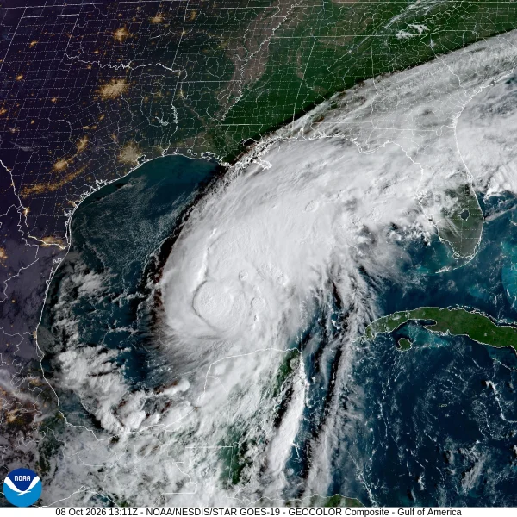
Hurricane Isaias
Event Summary
October 8, 2026: Hurricane Isaias became a Category 2 hurricane reaching 105 mph sustained winds, shortly before landfall.
October 9, 2026: Hurricane Isaias made landfall near Destin, Florida.
October 10, 2026: Transitioned to post-tropical storm over southern Alabama.
Late-season arrival came amid harvest for cotton, peanuts, soybeans, pecans, and other row crops.
Producers faced flooding, high winds, and field access issues, with potential for harvest disruption and crop loss.
October 8, 2026 1:11pm, Hurricane Isaias over the Gulf of America. Image Source: NOAA

Slide 3
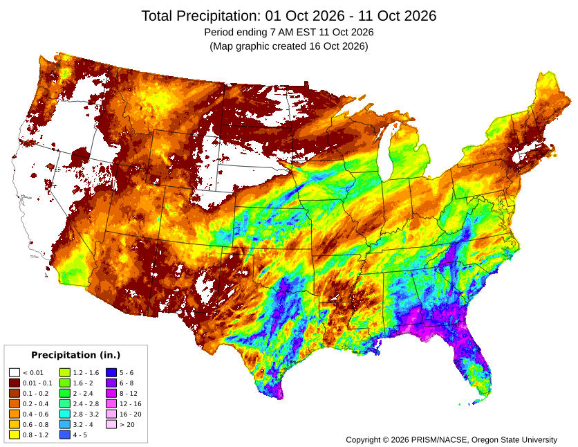
Total Precipitation Month-to-Date: October 1–11, 2026
Total Precipitation from October 1–11, 2026 (period ending 7am).
Credit: PRISM/Northwest Alliance for Computational Science and Engineering, Oregon State University

Slide 4
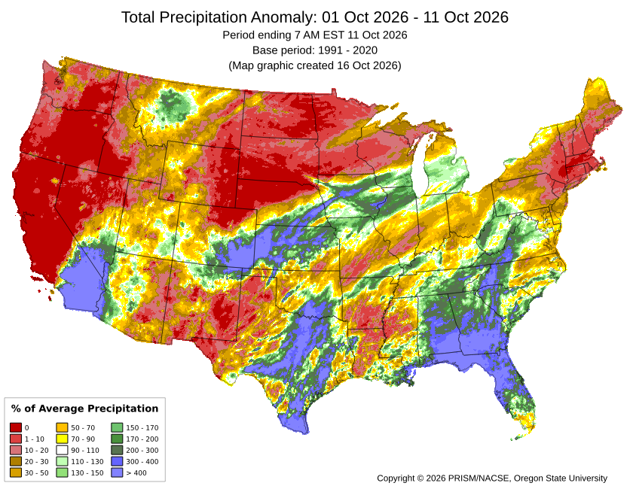
Total Precipitation Anomaly Month-to-Date: October 1–11, 2026
Total Precipitation Anomaly from October 1–11, 2026 (period ending 7am).
Anomalies show how observed values deviate from the 30-year normals (long-term averages).
Credit: PRISM/Northwest Alliance for Computational Science and Engineering, Oregon State University

Slide 5
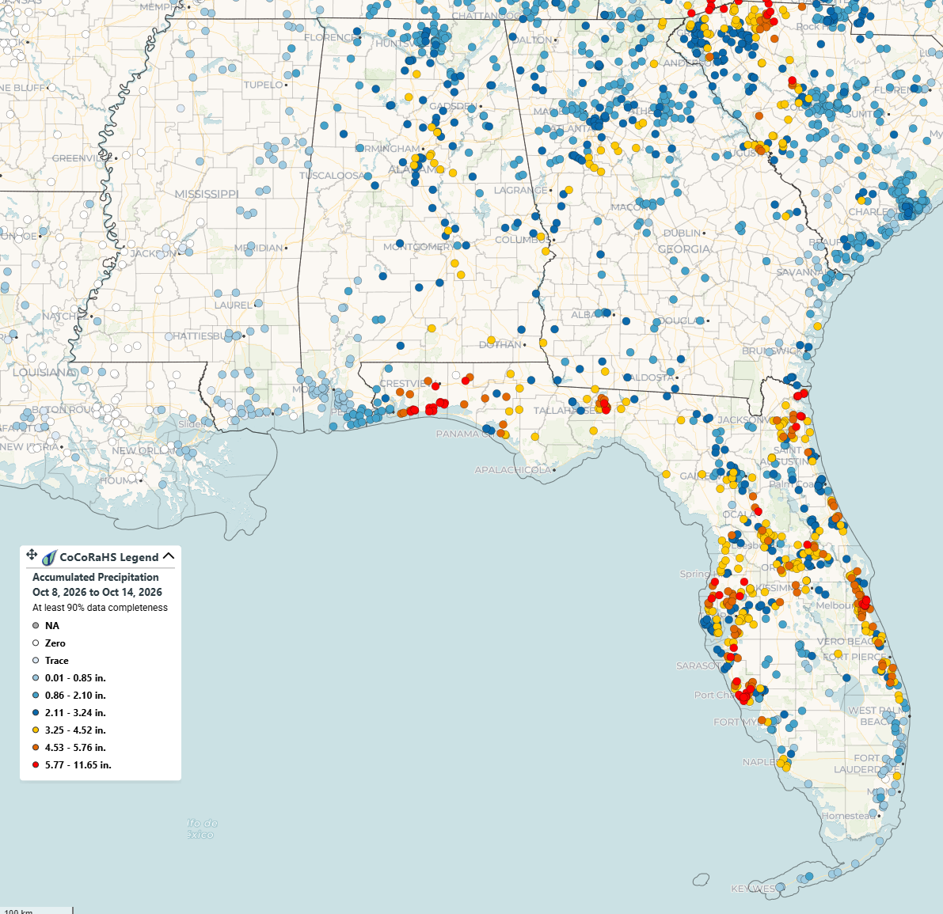
CoCoRaHS Accumulated Precipitation Data October 8–14, 2026
Accumulated Precipitation from October 8–14, 2026. Credit: CoCoRaHS Mapping System

Slide 6
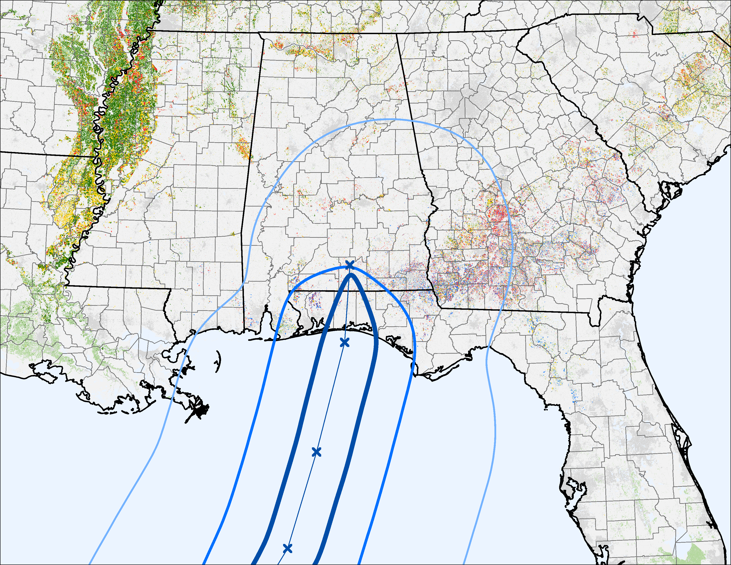
NOAA Hurricane Windspeeds – October 10, 2026
SC
Corn
MS
AL
GA
Soybeans
Cotton
Peanuts
Other Crops
Windspeed 64+ knots
Oct 10 6am
Windspeed 50-63 knots
Windspeed 34-49 knots
LA
Oct 10 12am
Credit: NOAA National Hurricane Center and Central Pacific Hurricane Center Hurricane Windspeeds – October 10, 2026, and the 2025 Cropland Data Layer.
FL
Oct 9 6pm
Oct 9 12pm

Slide 7
NOAA Hurricane Windspeeds – October 10, 2026
Alabama
 | Statewide Total Acres (2025)* | Percent within 64+ knots† | Percent within 50+ knots† | Percent within 34+ knots†
Corn | 345,000 | 0.3% | 4.6% | 39.5%
Soybeans | 295,000 | 0.2% | 3.9% | 24.7%
Cotton | 290,000 | 1.4% | 8.2% | 63.9%
Peanuts | 195,000 | 1.4% | 16.3% | 99.5%
Oats | N/A | 2.4% | 24.1% | 97.6%
Sorghum | N/A | 0.4% | 8.1% | 86.0%
Pecans | N/A | 3.5% | 11.7% | 95.3%
Georgia
 | Statewide Total Acres (2025)* | Percent within 64+ knots† | Percent within 50+ knots† | Percent within 34+ knots†
Corn | 550,000 | N/A | N/A | 47.3%
Soybeans | 155,000 | N/A | N/A | 36.0%
Cotton | 835,000 | N/A | N/A | 53.9%
Peanuts | 915,000 | N/A | N/A | 50.1%
Oats | 85,000 | N/A | N/A | 42.7%
Sorghum | N/A | N/A | N/A | 46.4%
Pecans | 145,000 | N/A | N/A | 54.1%
*Total statewide acres based on 2025 NASS official estimates for planted acres (corn, soybeans, cotton, peanuts, oats, and sorghum) and bearing acres (pecans), downloaded on October 20, 2026.
†Percentages based on raw pixel counts from the 2025 10m Cropland Data Layer and are not official NASS estimates. Estimates of potential cropland affected by hurricane winds may be different than these estimates indicate. Hurricane preliminary best track wind swath data obtained from the NOAA National Hurricane Center.
Florida
 | Statewide Total Acres (2025)* | Percent within 64+ knots† | Percent within 50+ knots† | Percent within 34+ knots†
Corn | 85,000 | 1.5% | 20.7% | 44.4%
Soybeans | N/A | 4.4% | 37.7% | 68.6%
Cotton | 61,000 | 4.2% | 38.9% | 91.8%
Peanuts | 177,000 | 2.3% | 27.0% | 63.5%
Oats | N/A | 3.6% | 12.8% | 66.9%
Sorghum | N/A | 2.4% | 12.4% | 73.3%
Pecans | N/A | 14.5% | 30.4% | 65.3%

Slide 8
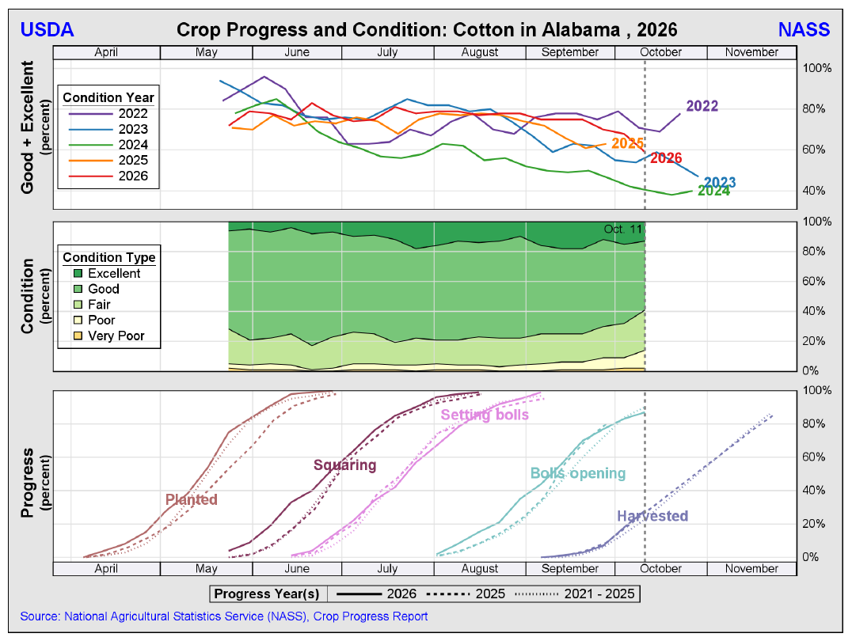
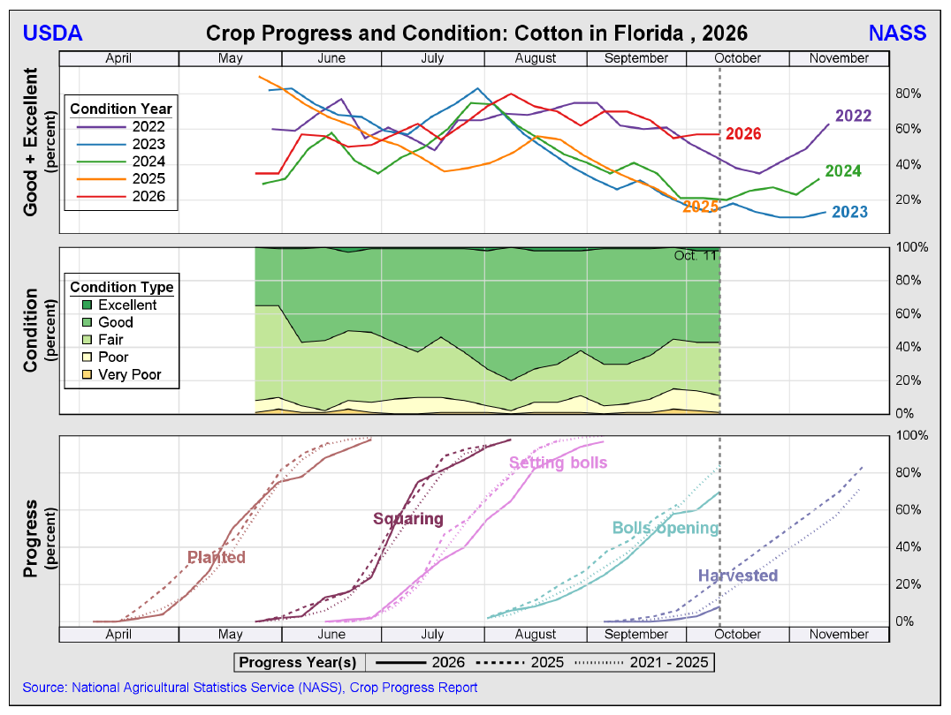
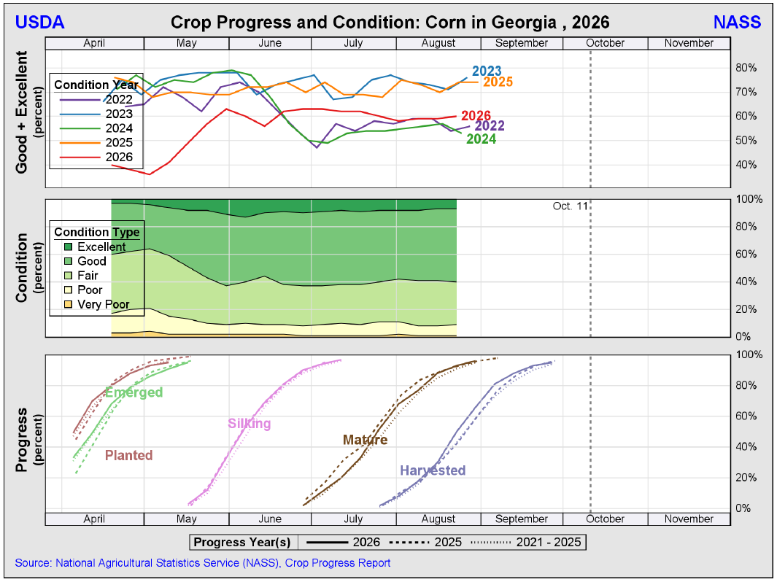
Cotton Crop Progress & Condition – October 11, 2026

Slide 9
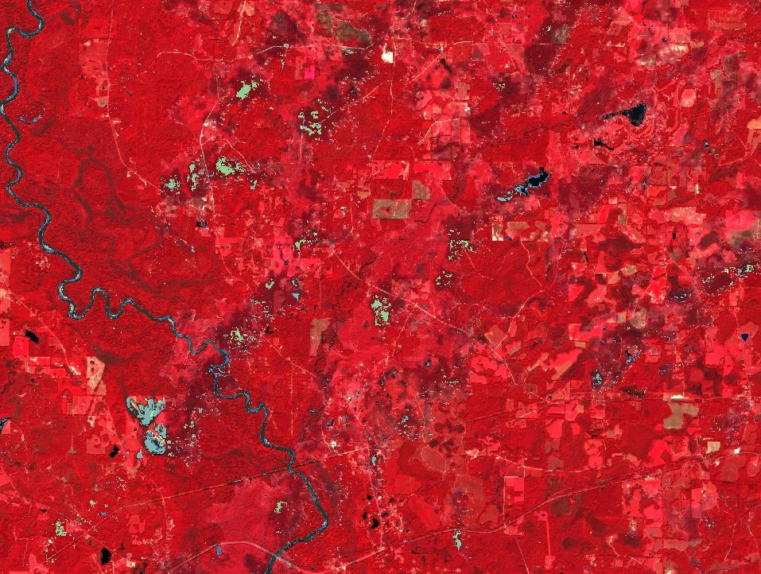
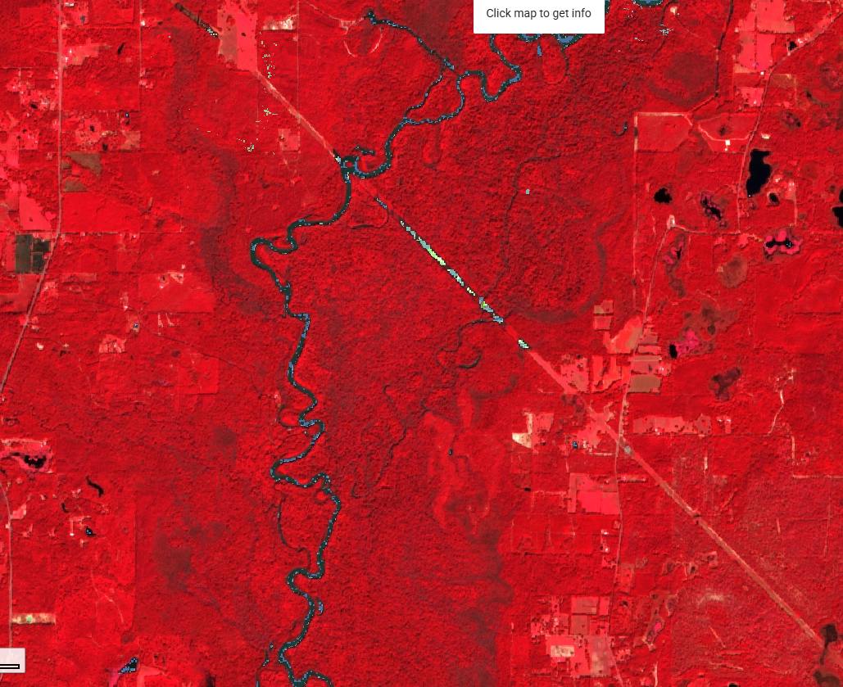
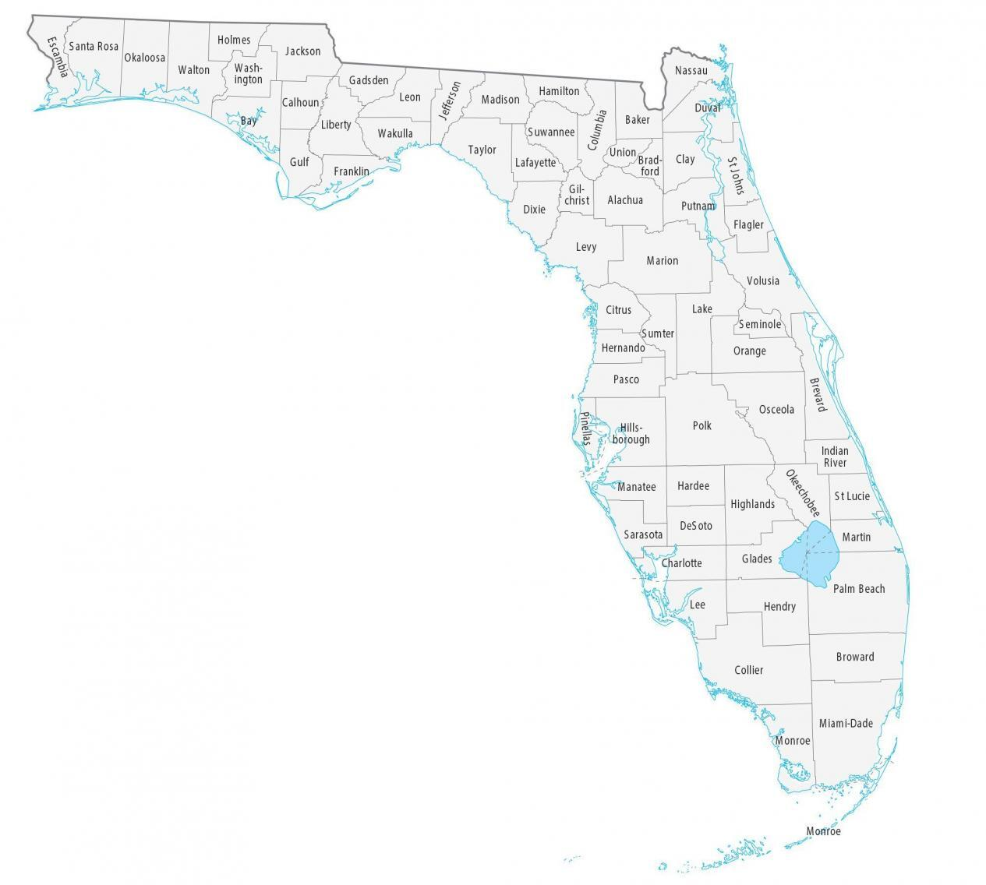
Inundation Analysis – No Significant Crop Inundation Detected
No significant crop inundation was detected from SAR and optical imagery from October 9 through 19, 2026 within the path of Hurricane Isaias. Most anomalies detected in croplands from SAR images were due to harvest, not flooding. The majority of flooded areas were wetlands, riverbanks, and some roads.
Forest
Utility Corridor
Water/
Wetlands
Walton and Washington Counties, Florida
Holmes County, Florida
Wetlands
Post-Event: Sentinel-2 SR median composite (Oct 9–19, 2026)
Post-Event: Sentinel-2 SR median composite (Oct 9–19, 2026)
Real-time Assessment and Prompt Inundation Detection (RAPID V2.1 Beta) was designed for near-real time flood extent mapping and depth estimation using multi-sensor remote sensing data such as ESA Copernicus Sentinel-1 C-band SAR imagery, Sentinel-2, USGS Landsat 8/9, USGS 3DEP National Map Seamless 1/3 Arc-Second DEM, etc. Maximum flood inundation conditions are reflected for specified time windows. The 2025 USDA NASS Cropland Data Layer (CDL) is integrated in this app for the use of crop impact assessment. Author: Dr. Zhe Li (zhe.li@usda.gov).

Slide 10
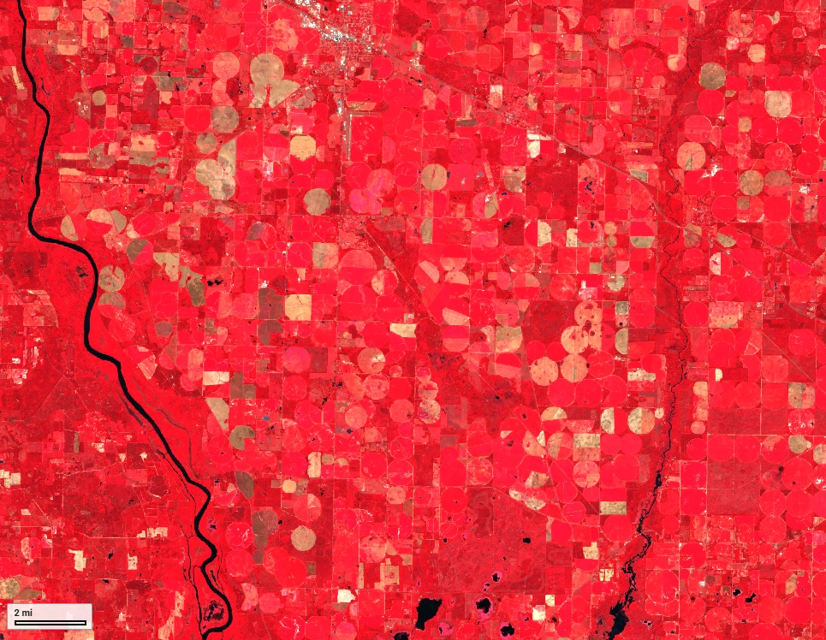
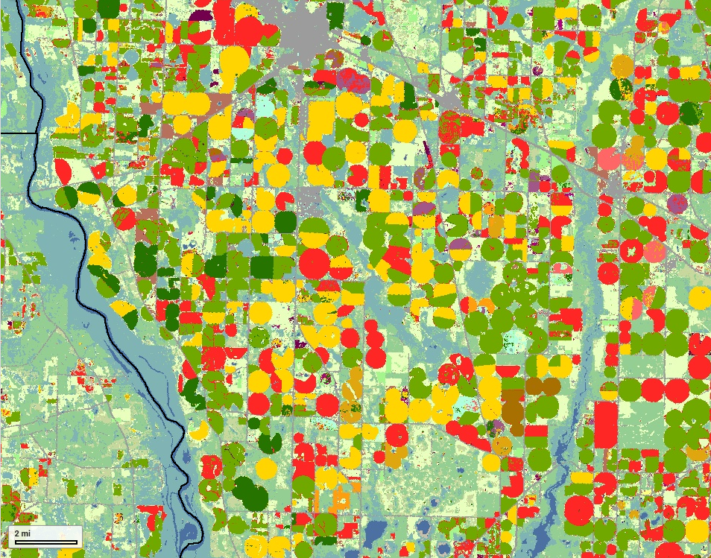
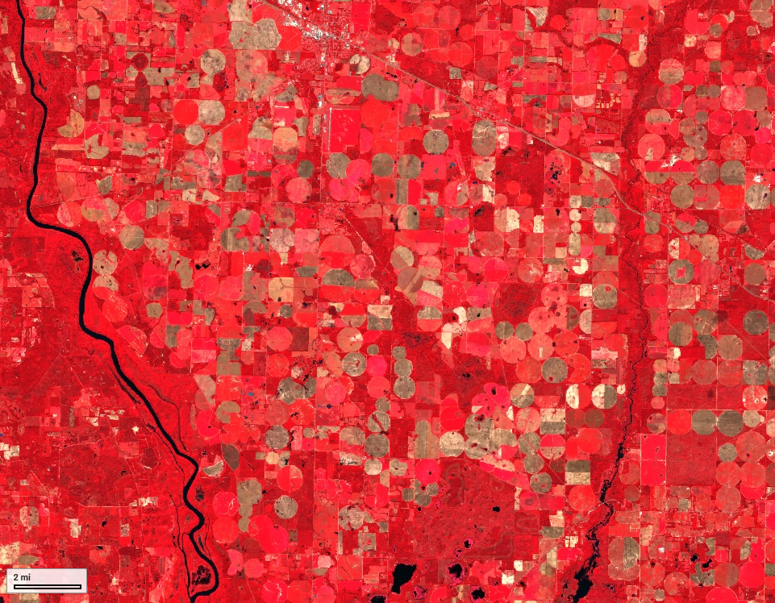
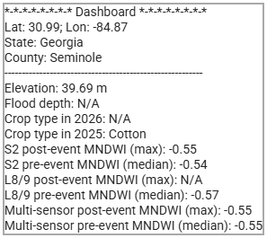
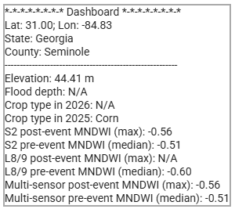
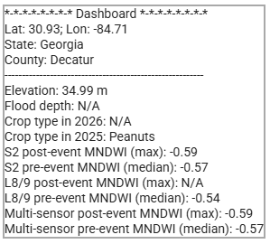
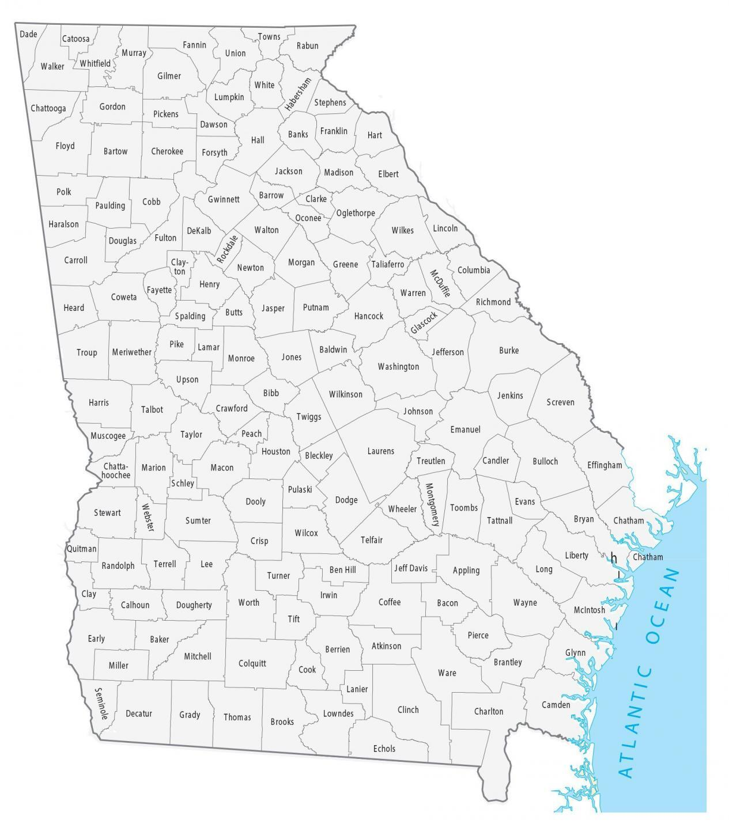
Inundation Analysis – No Significant Crop Inundation Detected
10
Pre-Event: Sentinel-2 SR median composite (Sep 1–Oct 1, 2026)
CDL 2025
Post-Event: Sentinel-2 SR median composite (Oct 9–19, 2026)
Cotton
Corn
Peanuts
Seminole and Decatur Counties, Georgia
Corn
Cotton
Peanuts
Negative post-event MNDWI indicates no standing water.

Slide 11
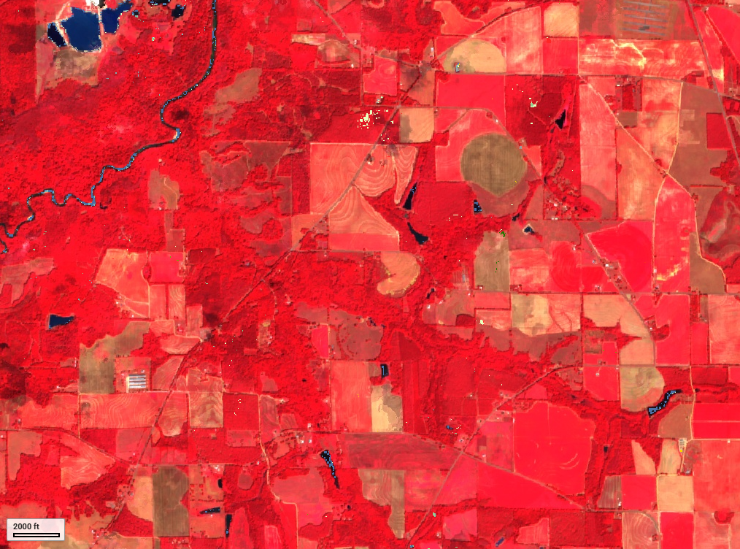
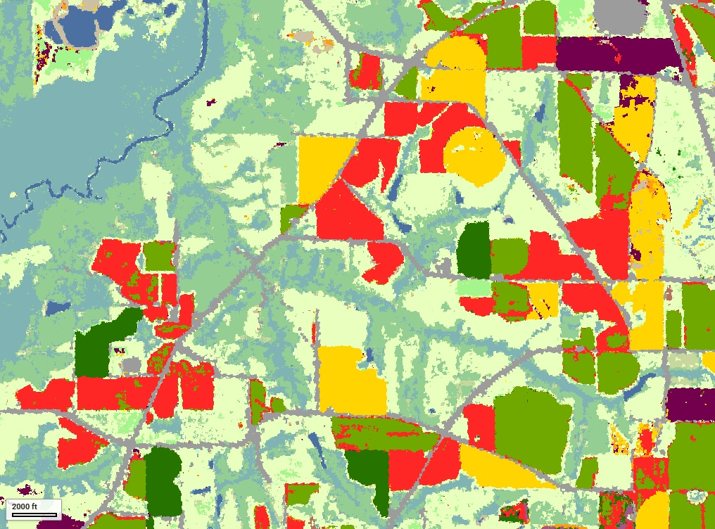
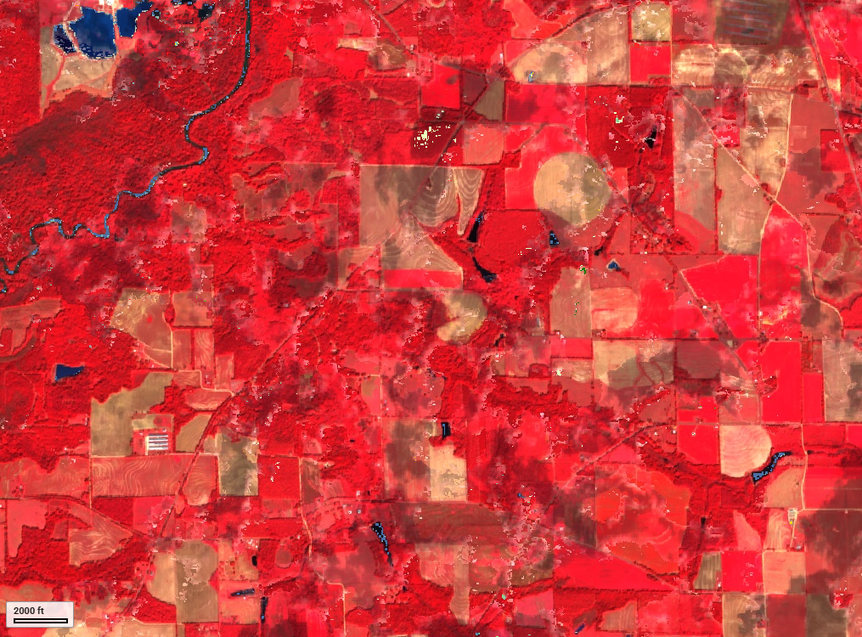
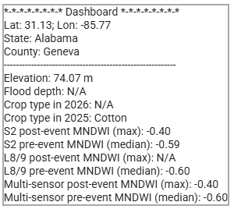
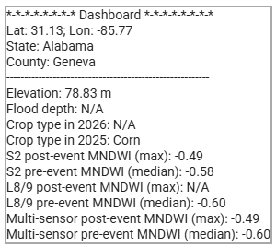
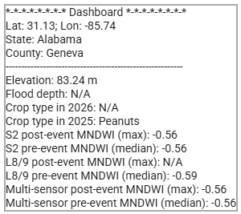
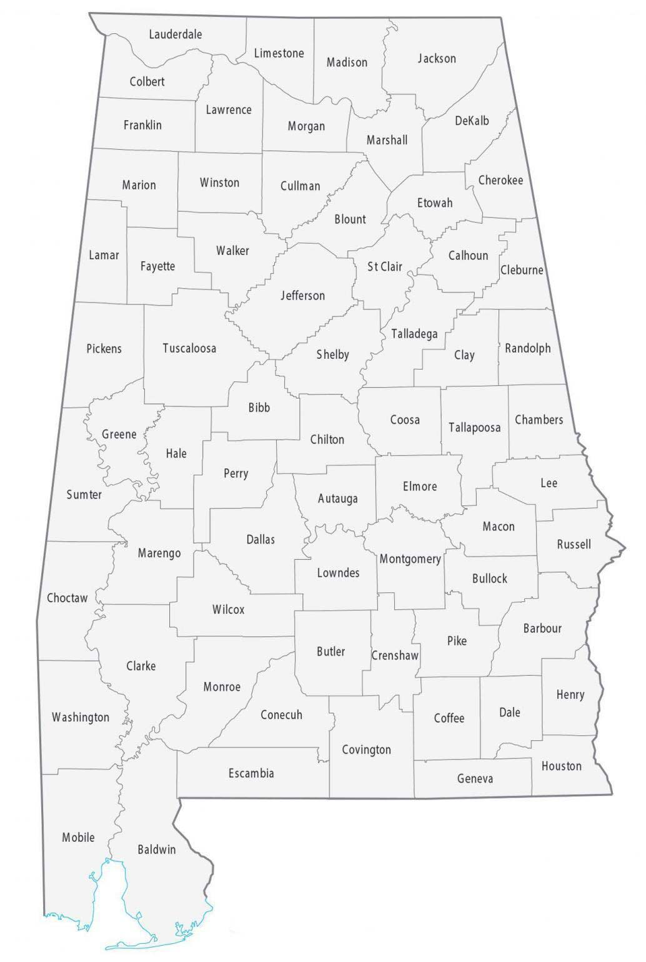
Inundation Analysis – No Significant Crop Inundation Detected
11
Pre-Event: Sentinel-2 SR median composite (Sep 1–Oct 1, 2026)
CDL 2025
Post-Event: Sentinel-2 SR median composite (Oct 9–19, 2026)
Cotton
Corn
Peanuts
Geneva County, Alabama
Corn
Cotton
Peanuts
Negative post-event MNDWI indicates no standing water.

Slide 12
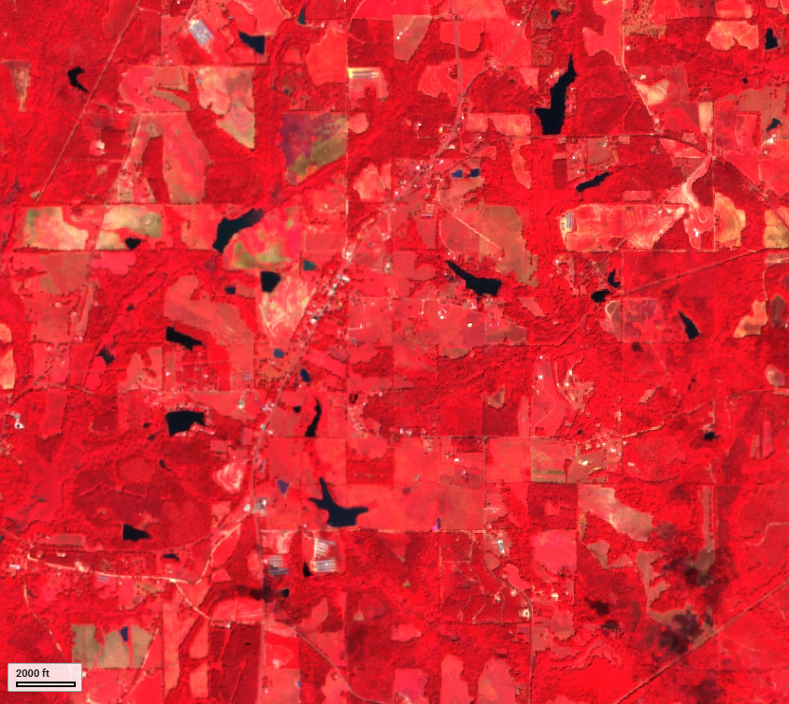
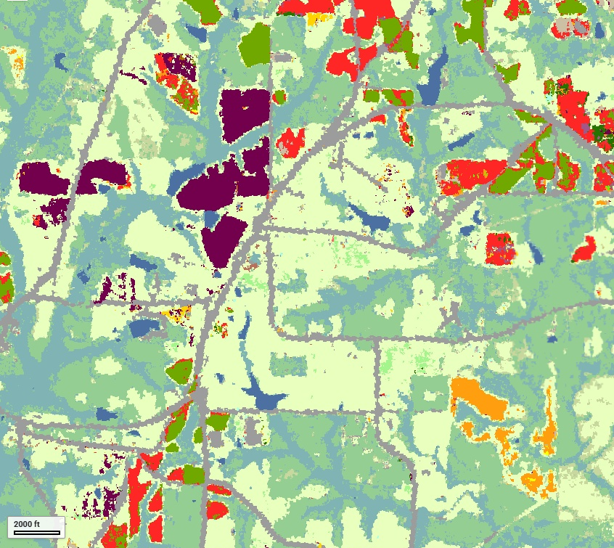
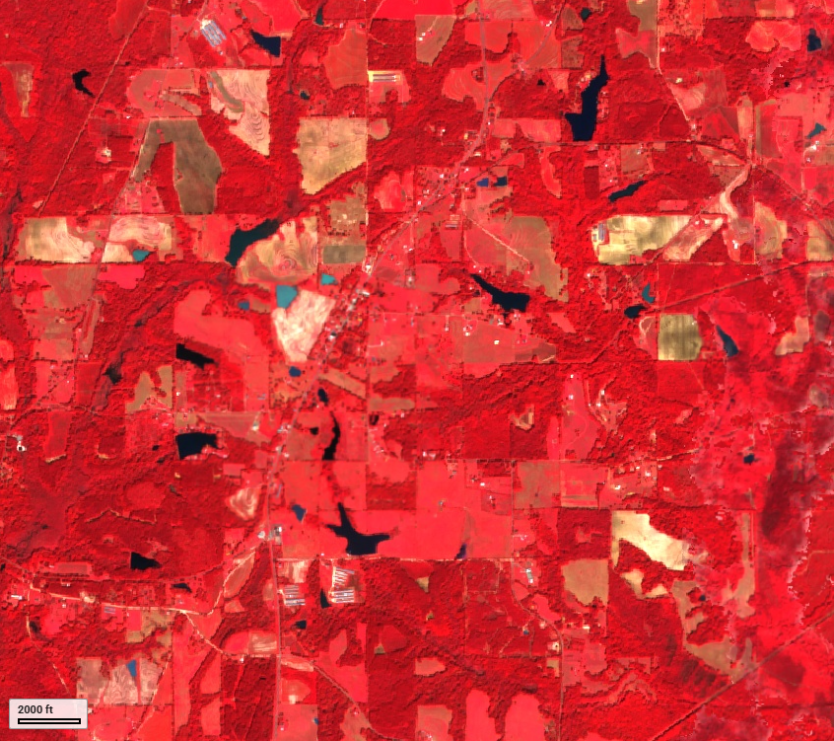
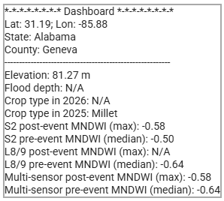
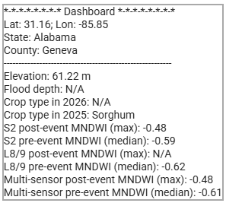
Inundation Analysis – No Significant Crop Inundation Detected
12
Pre-Event: Sentinel-2 SR median composite (Sep 1–Oct 1, 2026)
CDL 2025
Post-Event: Sentinel-2 SR median composite (Oct 9–19, 2026)
Millet
Sorghum
Geneva County, Alabama
Millet
Sorghum
Negative post-event MNDWI indicates no standing water.

Slide 13
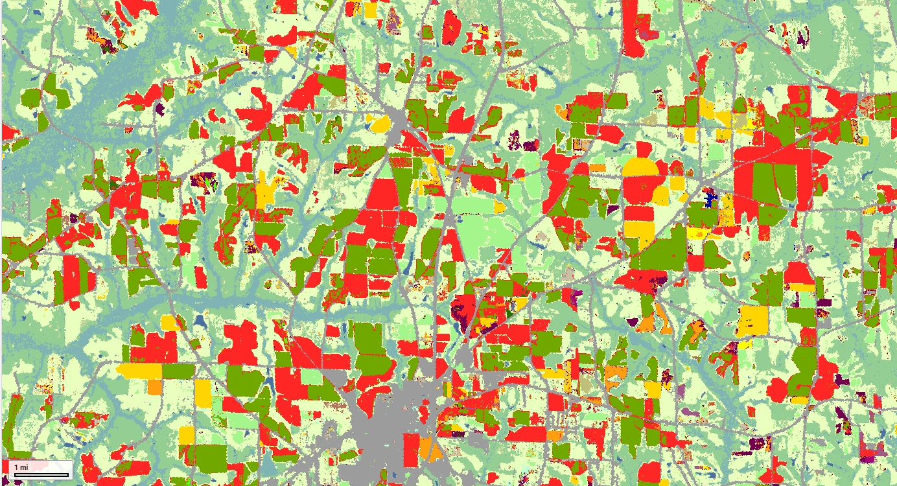
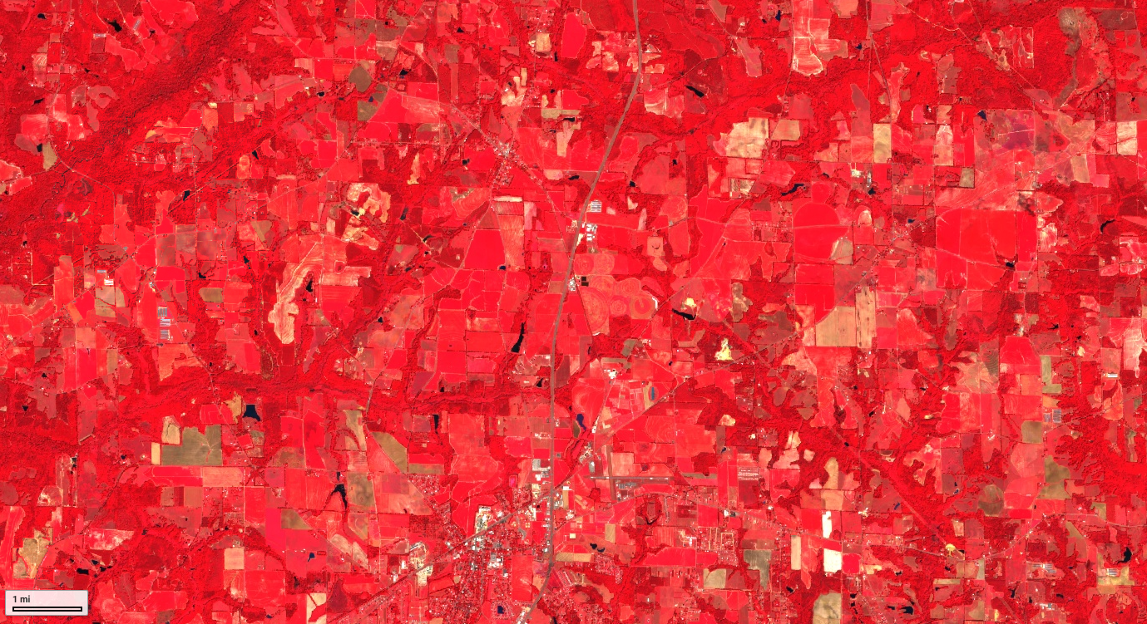
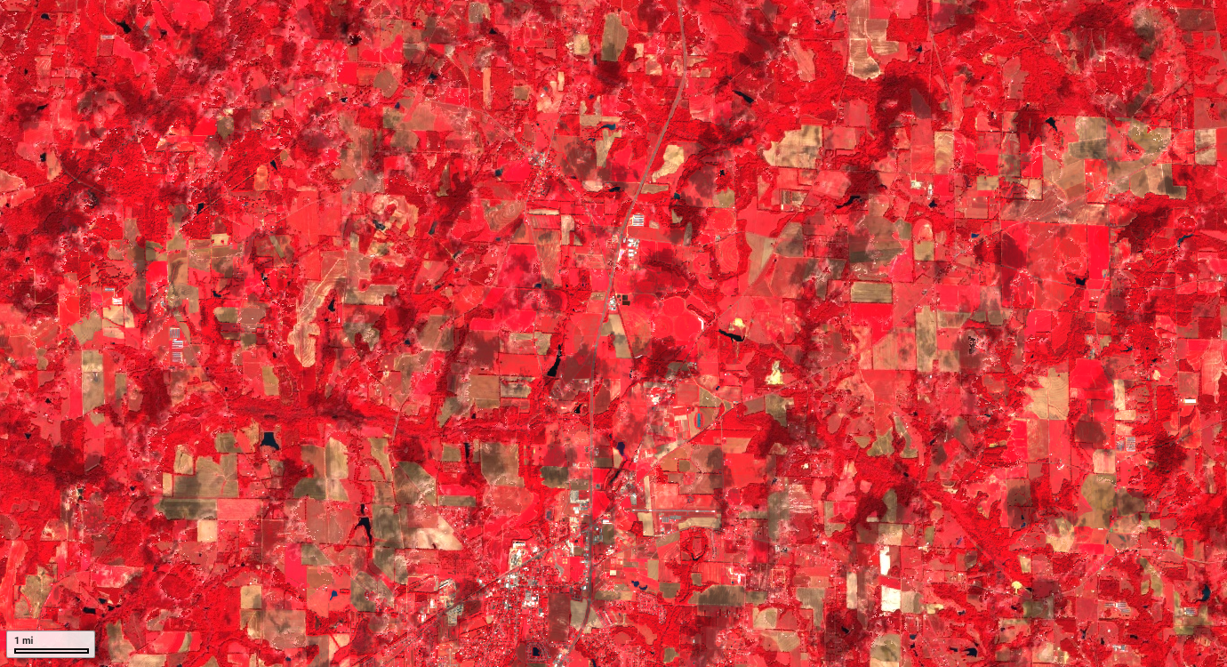
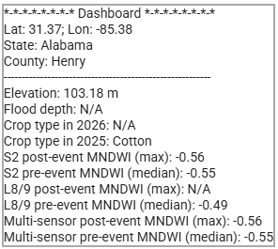
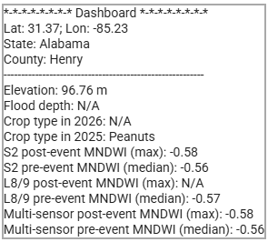
Inundation Analysis – No Significant Crop Inundation Detected
Corn
Cotton
Peanuts
CDL 2025
Pre-Event: Sentinel-2 SR median composite (Sep 1–Oct 1, 2026)
Cotton
Peanuts
Henry County, Alabama
Negative post-event MNDWI indicates no standing water.
Post-Event: Sentinel-2 SR median composite (Oct 9–19, 2026)

Slide 14
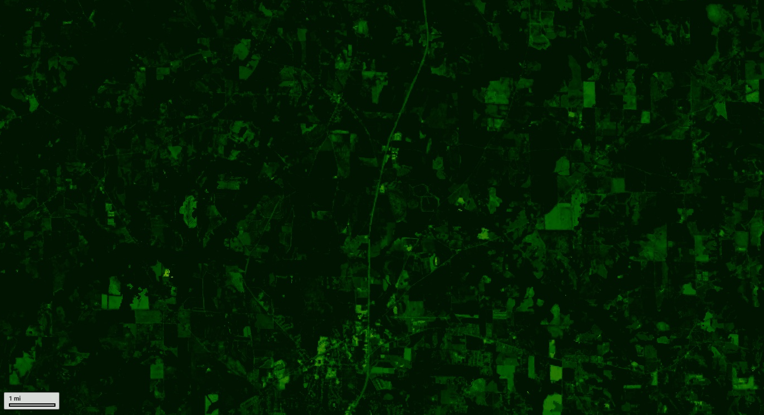
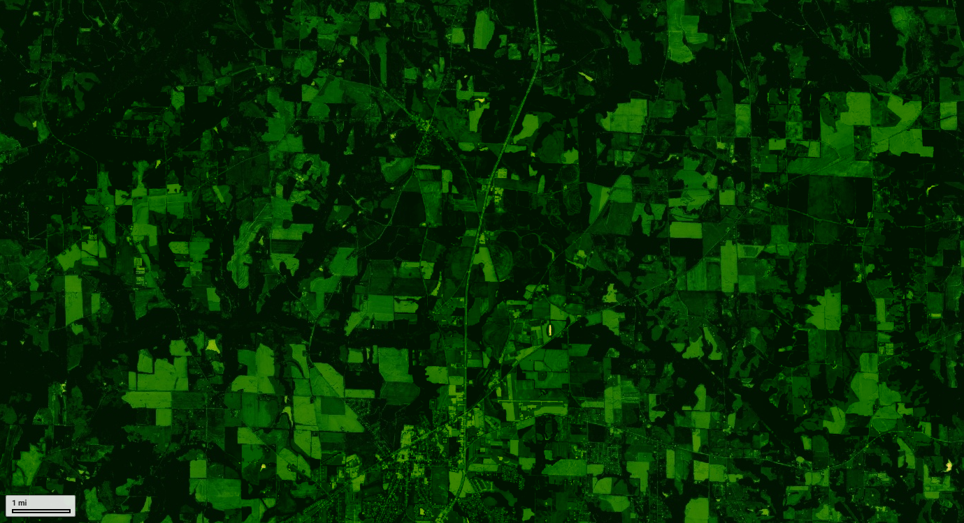
Inundation Analysis – No Significant Crop Inundation Detected
Pre-Event: Higher NDVI
Corn
Cotton
Peanuts
CDL 2025
Pre-Event: Multi-sensor (Sentinel-2, Landsat 8/9) NDVI median composite (Sep 1–Oct 1, 2026)
Post-Event: Lower NDVI
Henry County, Alabama
High NDVI
As year progresses, NDVI drops due to many factors including harvest, end of season, wind damages, etc.
Low NDVI
Post-Event: Multi-sensor (Sentinel-2, Landsat 8/9) NDVI median composite (Oct 9–19, 2026)

