Slide 1
Texas Floods
July 2025
USDA NASS Disaster Monitoring Team
Report last updated: July 17, 2025
https://www.nass.usda.gov/Research_and_Science/Disaster-Analysis/index.php

Slide 2
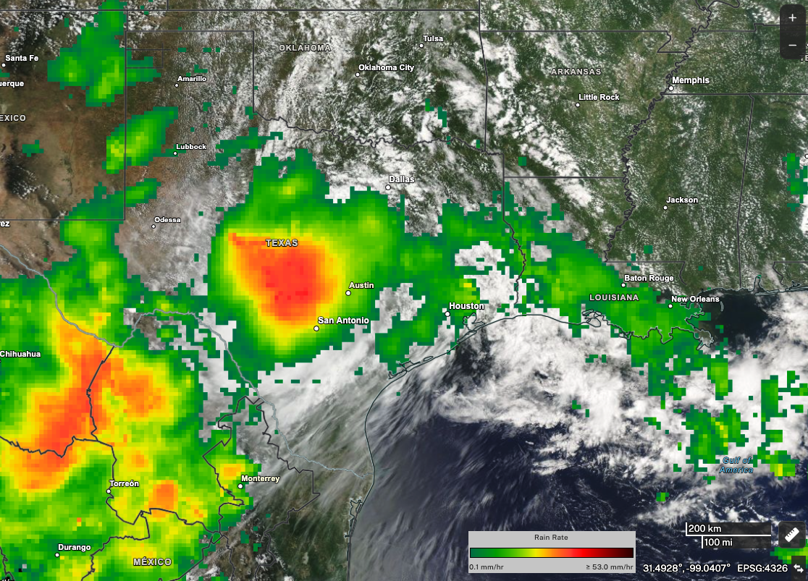
Texas Floods
Event Summary
Heavy rainfall in early July triggered by Tropical Storm Barry resulted in catastrophic flooding across Central Texas, the Hill Country, and Concho Valley.
Communities along the Guadalupe River, which reached a major flood stage, were devastated.
Flash flooding resulted in significant loss of life, damage to property, and flooded croplands.
1-day precipitation totals from NASA’s IMERG multi-satellite precipitation product show heavy rainfall over central Texas on July 4, 2025.
Credit: NASA Worldview, Jacob Reed (NASA GSFC). Image Source: NASA
Event Information Sources:
https://tdem.texas.gov/disasters/july-flooding-25-0026
https://appliedsciences.nasa.gov/what-we-do/disasters/disasters-activations/texas-flooding-july-2025
https://texasagriculture.gov/News-Events/Article/10455/COMMISSIONER-SID-MILLER-DEPLOYS-TDA-RESOURCES-TO-AID-TEXANS-IMPACTED-BY-DEVASTA
https://www.khou.com/article/news/state/texas-news/texas-flood/texas-hill-country-flooding-timing-factors/285-e8b25b39-7e5f-4d2b-a4fd-8156b8ad815d

Slide 3
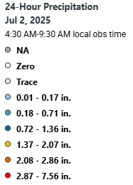
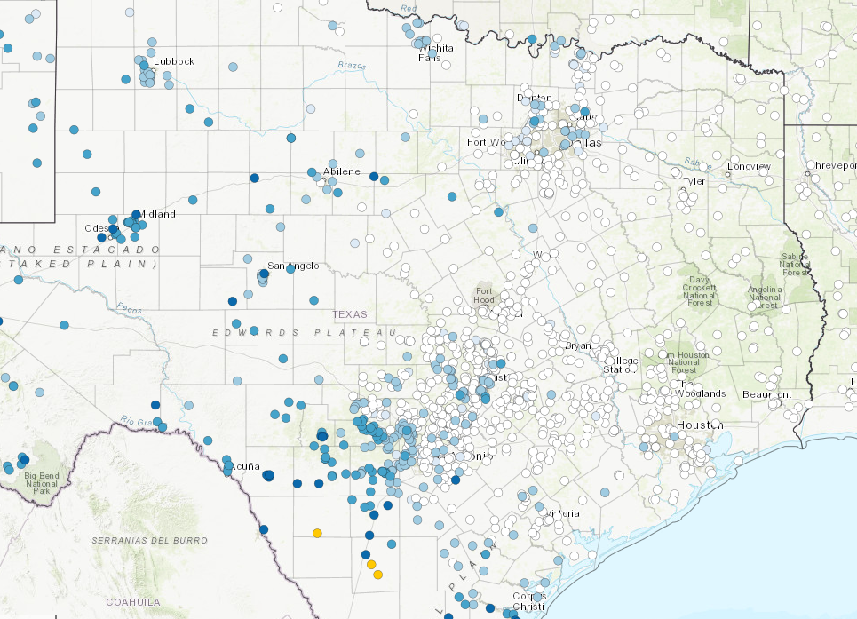
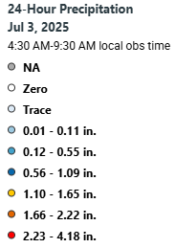
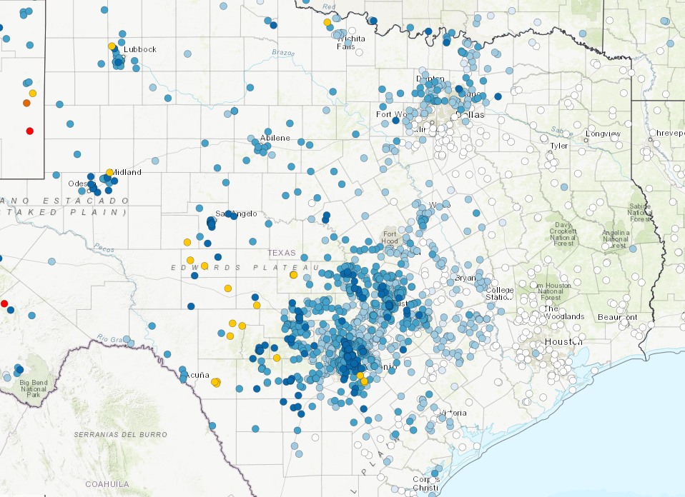
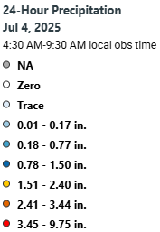
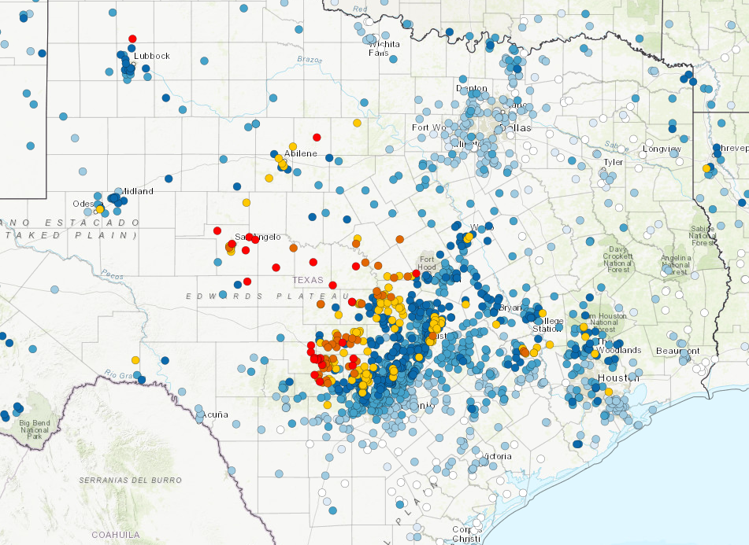
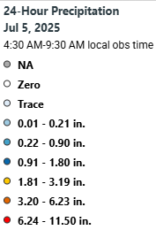
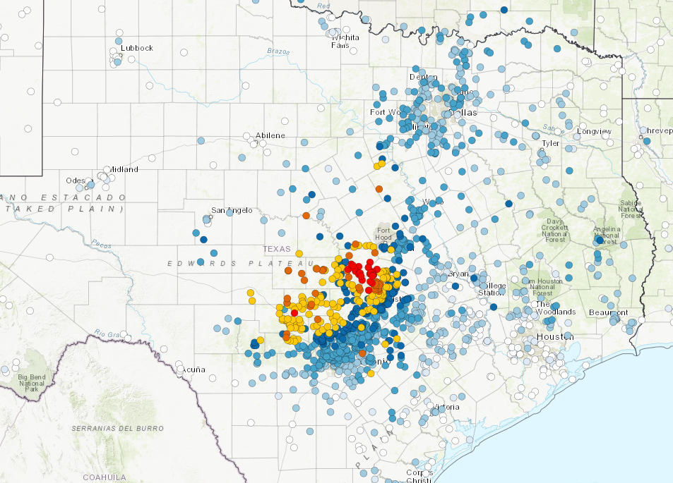
Texas Floods: 7/2 to 7/5
Daily Precipitation CoCoRaHS Data
July 2, 2025
July 3, 2025
July 4, 2025
July 5, 2025

Slide 4
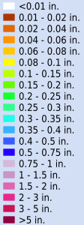
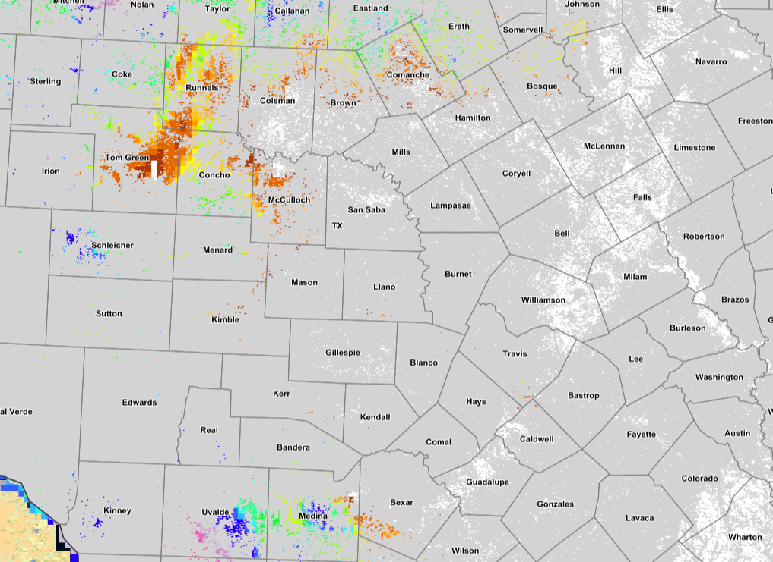
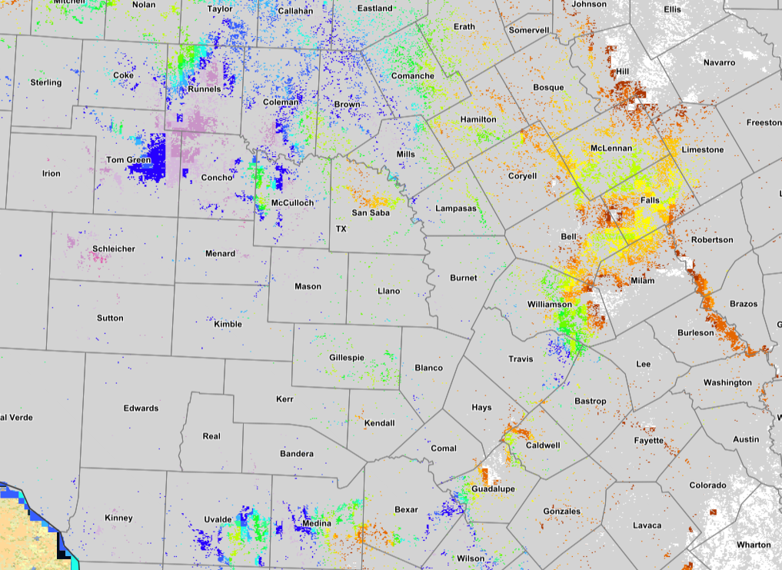
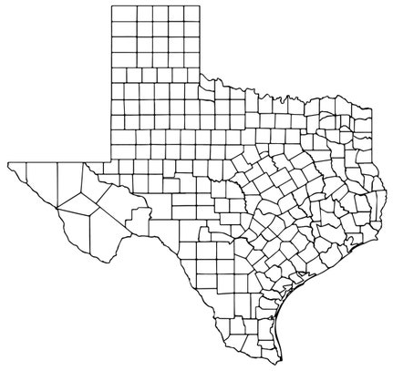
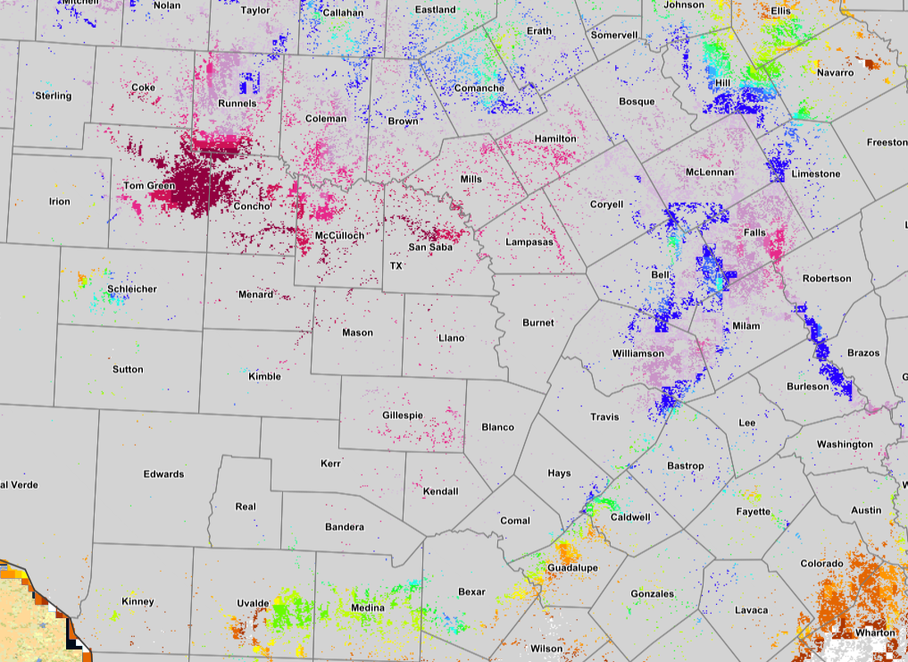
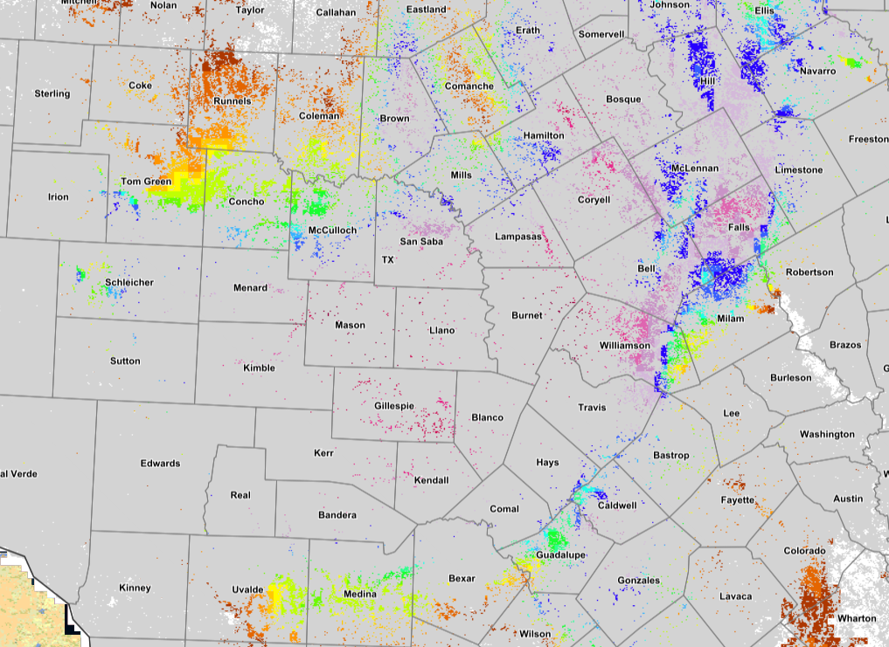
Texas Floods: 7/2 to 7/5
Daily Precipitation Totals Crop Mask
July 2, 2025
July 3, 2025
July 4, 2025
July 5, 2025
Precipitation data derived from PRISM/NACSE, Oregon State University (https://prism.oregonstate.edu/) and hosted on Crop-CASMA enabled by NSF CropSmart grant (https://nassgeo.csiss.gmu.edu/CropCASMA/)

Slide 5
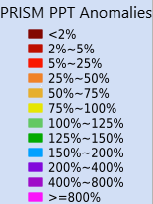
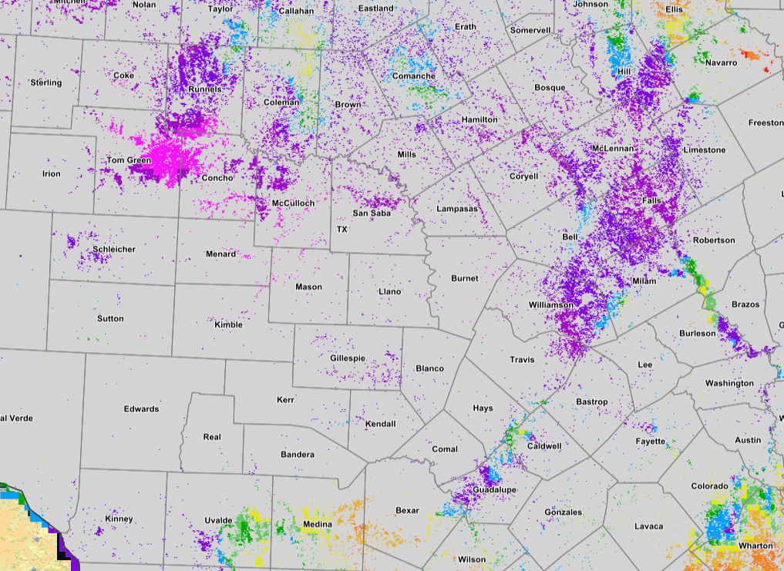
Texas Floods: 6/30 to 7/6
Weekly Precipitation Anomaly Crop Mask
Precipitation data derived from PRISM/NACSE, Oregon State University (https://prism.oregonstate.edu/) and hosted on Crop-CASMA enabled by NSF CropSmart grant (https://nassgeo.csiss.gmu.edu/CropCASMA/)

Slide 6
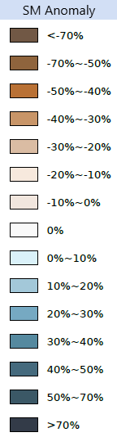
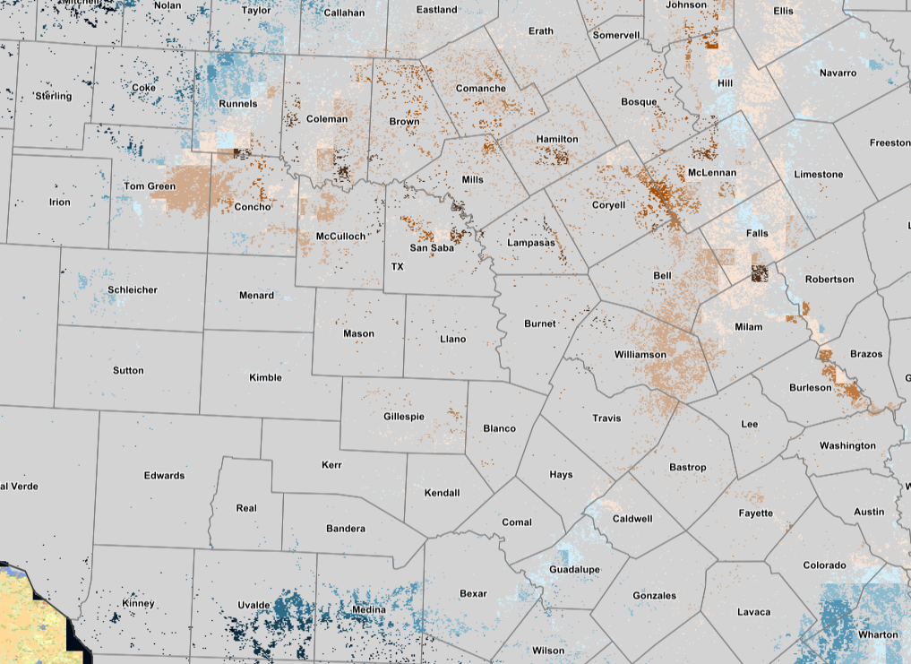
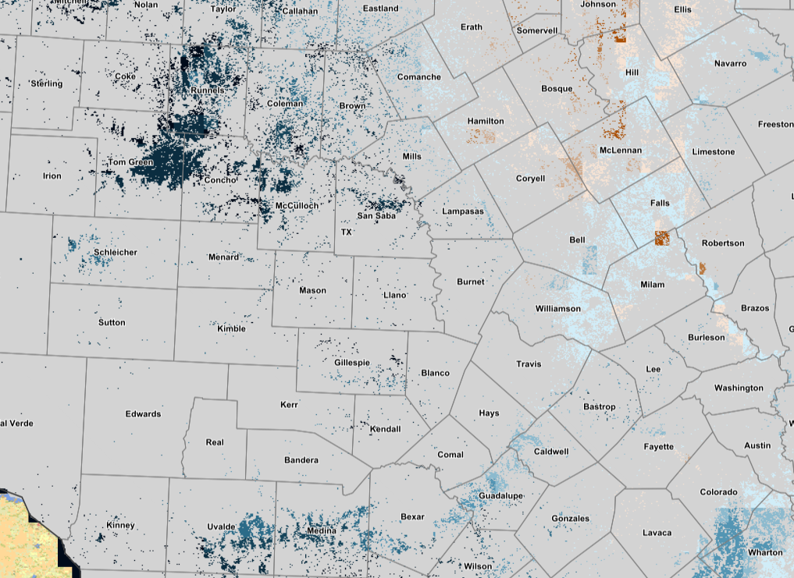
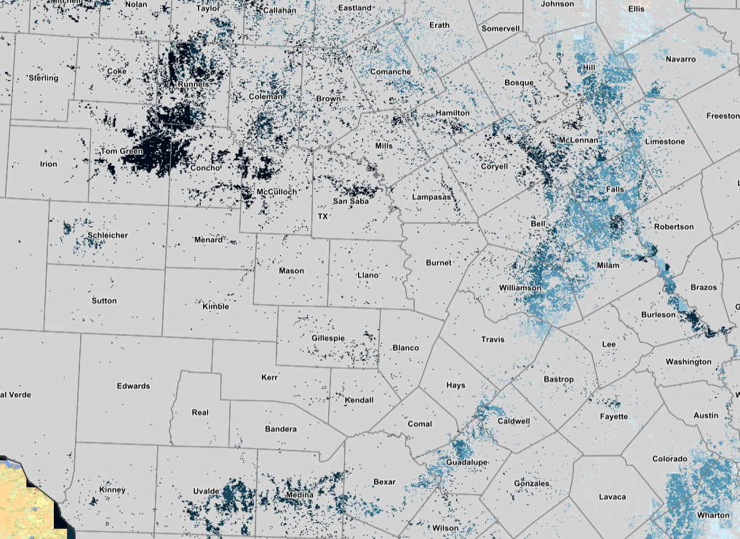
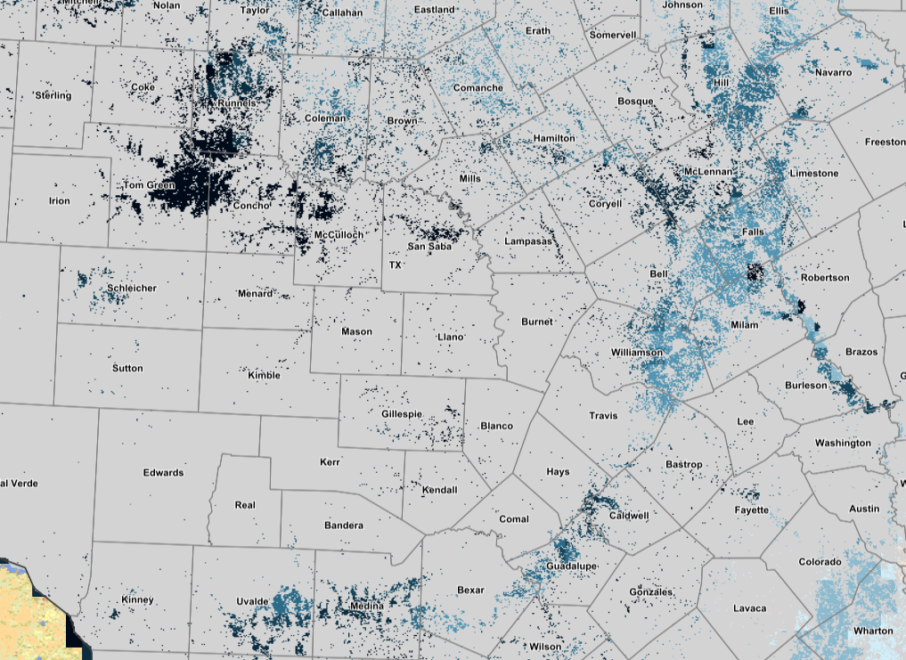
Texas Floods: 7/2 to 7/5
Daily Soil Moisture Anomaly Crop Mask
July 2, 2025
July 3, 2025
July 4, 2025
July 5, 2025
Data source: NASA SMAP, hosted on Crop-CASMA (https://nassgeo.csiss.gmu.edu/CropCASMA/)

Slide 7
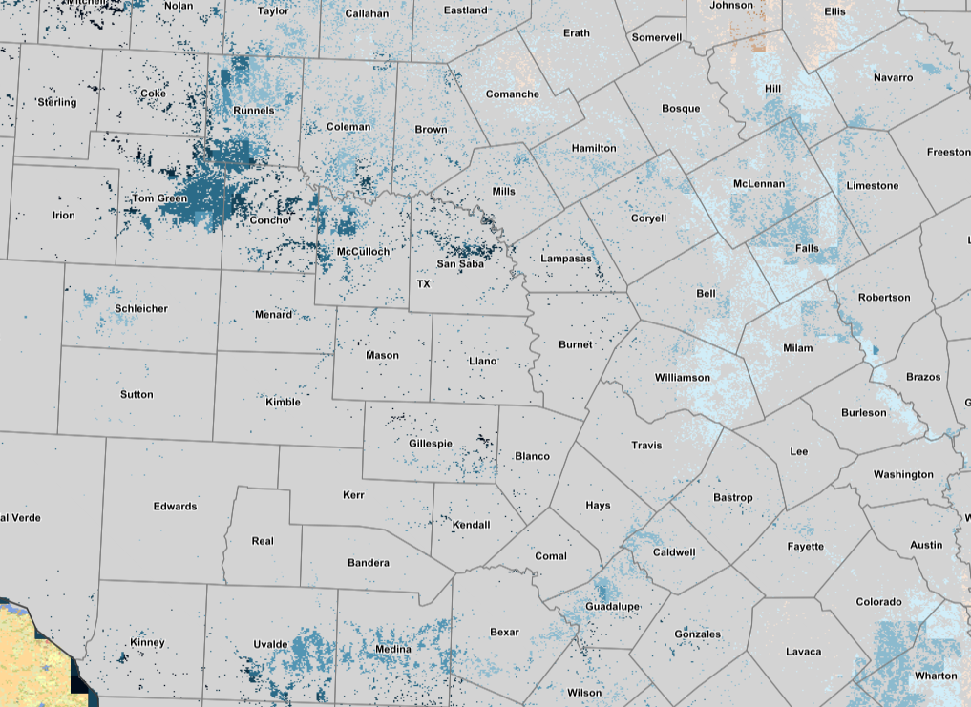
Texas Floods: 6/30 to 7/6
Weekly Soil Moisture Anomaly Crop Mask
Data source: NASA SMAP, hosted on Crop-CASMA (https://nassgeo.csiss.gmu.edu/CropCASMA/)

Slide 8
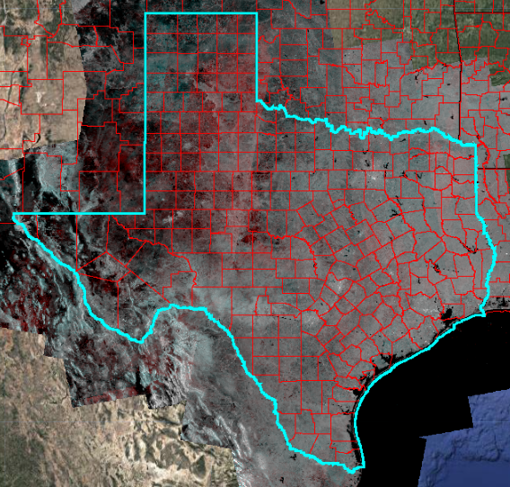
Texas Floods
Inundation Assessment Summary
Flood detection and crop impact assessment using multi-sensor remote sensing data (Sentinel-1, Sentinel-2, Landsat 8, and Landsat 9) and the 2024 Cropland Data Layer (CDL)
Pre-event assessment: June 1 – July 1, 2025
Post-event assessment: July 3 – 14, 2025
RAPID V2.0 Beta (Real-time Assessment and Prompt Inundation Detection)

Slide 9
Texas Floods
Crop Impact Summary
Corn Acres Impacted by 2025 TX Floods
County | NASS 2024 Acres Planted | Percent of Acres Impacted*
Bell | 69,800 | 0.99%
Bexar | 6,000 | 5.80%
Caldwell | 9,100 | 0.57%
Milam | 41,800 | 0.87%
Williamson | 98,300 | 0.52%
Cotton Acres Impacted by 2025 TX Floods
County | NASS 2024 Acres Planted | Percent of Acres Impacted*
McCulloch | 9,400 | 2.82%
Milam | 8,900 | 3.25%
Reagan | 55,700 | 0.75%
*Percent of acres impacted estimated using an updated GEE web app RAPID V2.0 Beta (Real-time Assessment and Prompt Inundation Detection) developed at USDA NASS, based on the 2024 CDL planted acres, and are not official NASS estimates.
RAPID V2.0 Beta (Real-time Assessment and Prompt Inundation Detection)

Slide 10
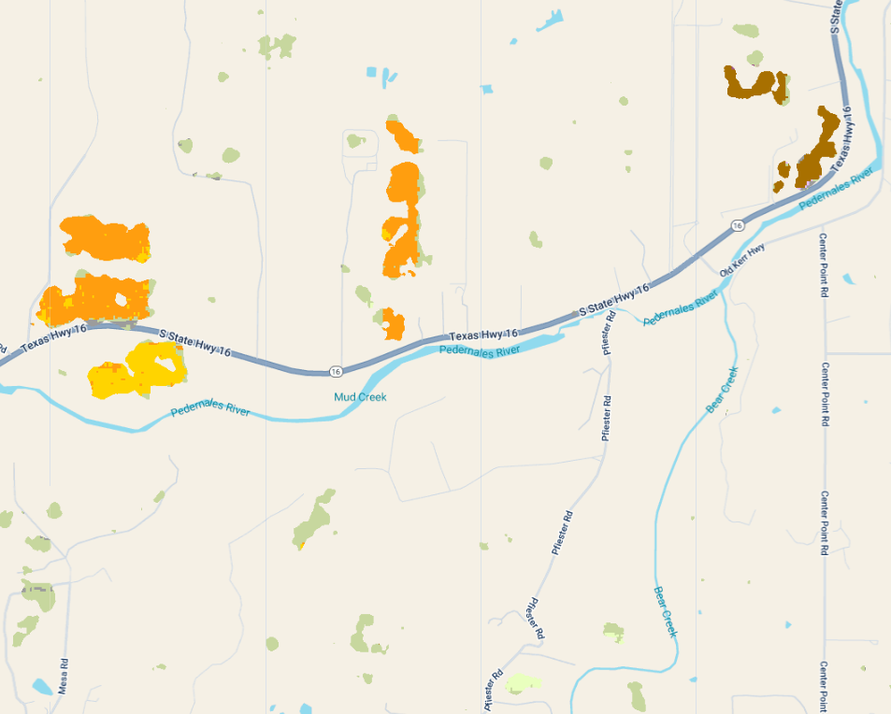
Texas Floods
Inundated Crop Example
Sorghum
Winter Wheat
Corn
Inundated cropland in Gillespie County near Morris Ranch

Slide 11
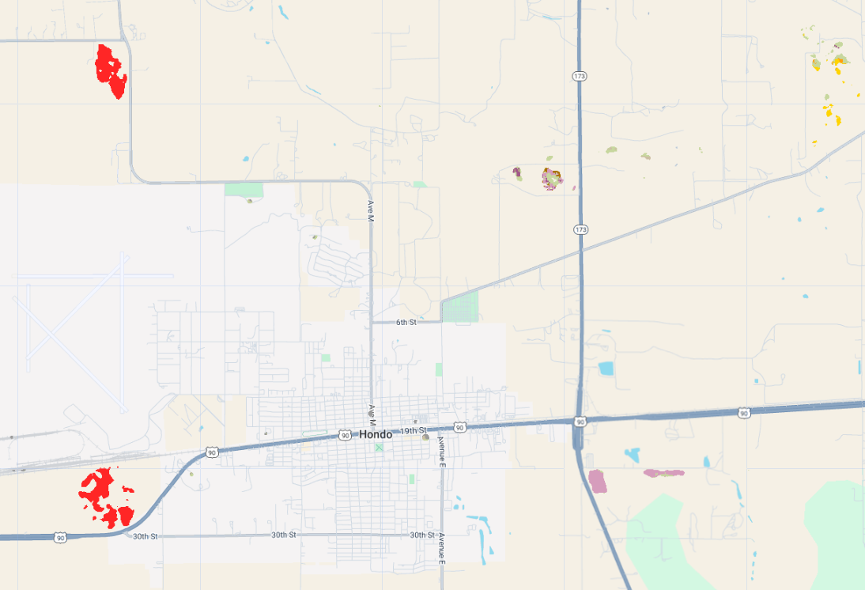
Texas Floods
Inundated Crop Example
Cotton
Triticale
Inundated cropland in Medina County near Hondo

Slide 12
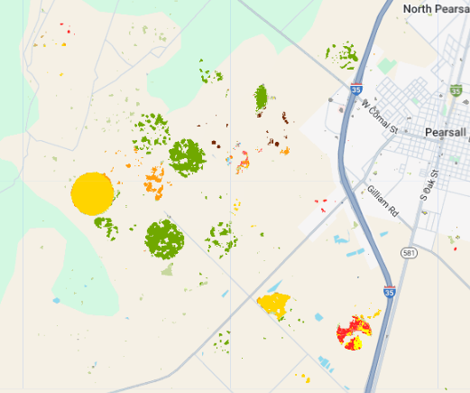
Texas Floods
Inundated Crop Example
Sorghum
Peanuts
Cotton
Corn
Sunflower
Inundated cropland in Frio County near Pearsall

Slide 13
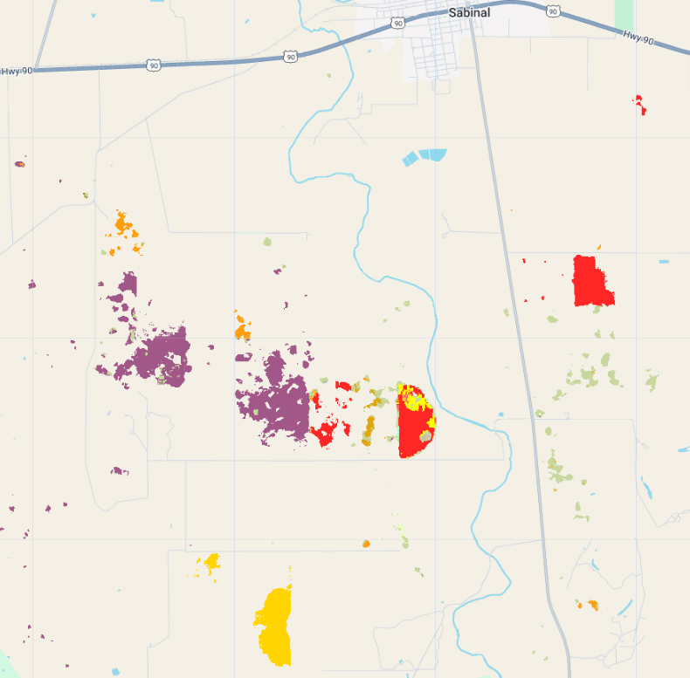
Texas Floods
Inundated Crop Example
Oats
Sunflower
Cotton
Corn
Inundated cropland in Uvalde County near Sabinal

Slide 14
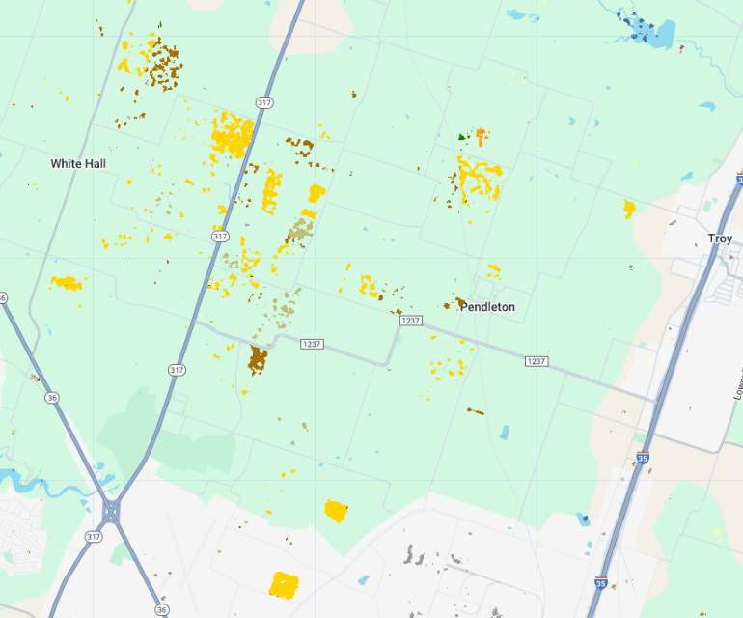
Texas Floods
Inundated Crop Example
Corn
Corn
Inundated cropland in Bell County near White Hall

Slide 15
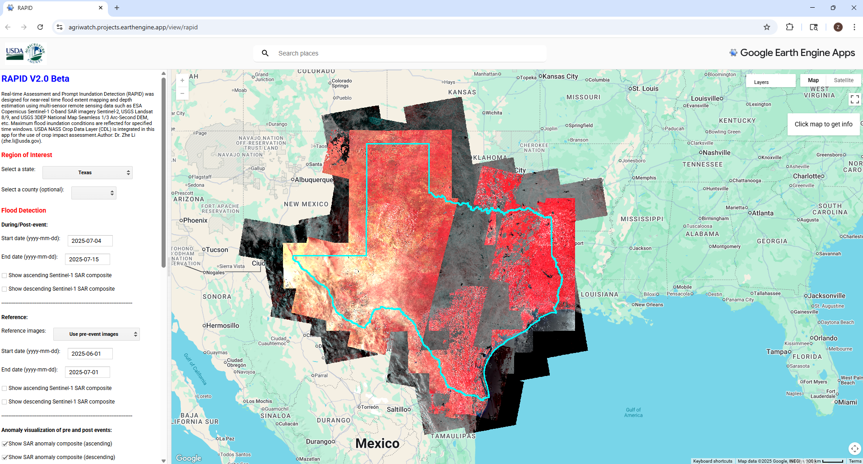

RAPID V2.0 Beta - Real-time Assessment and Prompt Inundation Detection
RAPID V2.0 Beta (Real-time Assessment and Prompt Inundation Detection)

