Slide 1
Midwest Derecho - 2023
Assessment Period: June 29, 2023
Publication Date: July 18, 20203
USDA NASS
Disaster Monitoring Team

Slide 2
Event Summary
Location: Midwest U.S. (Missouri, Illinois, Indiana, Kentucky and Tennessee)
Timeframe: June 29, 2023
Event: Midwest Derecho (https://www.weather.gov/dvn/summary_062923)
  A derecho tracked east across the Midwest on the morning of Thursday, June 29, 2023.
  Frequent winds above 80 mph caused widespread wind damage to crops, trees, and structures.

Slide 3
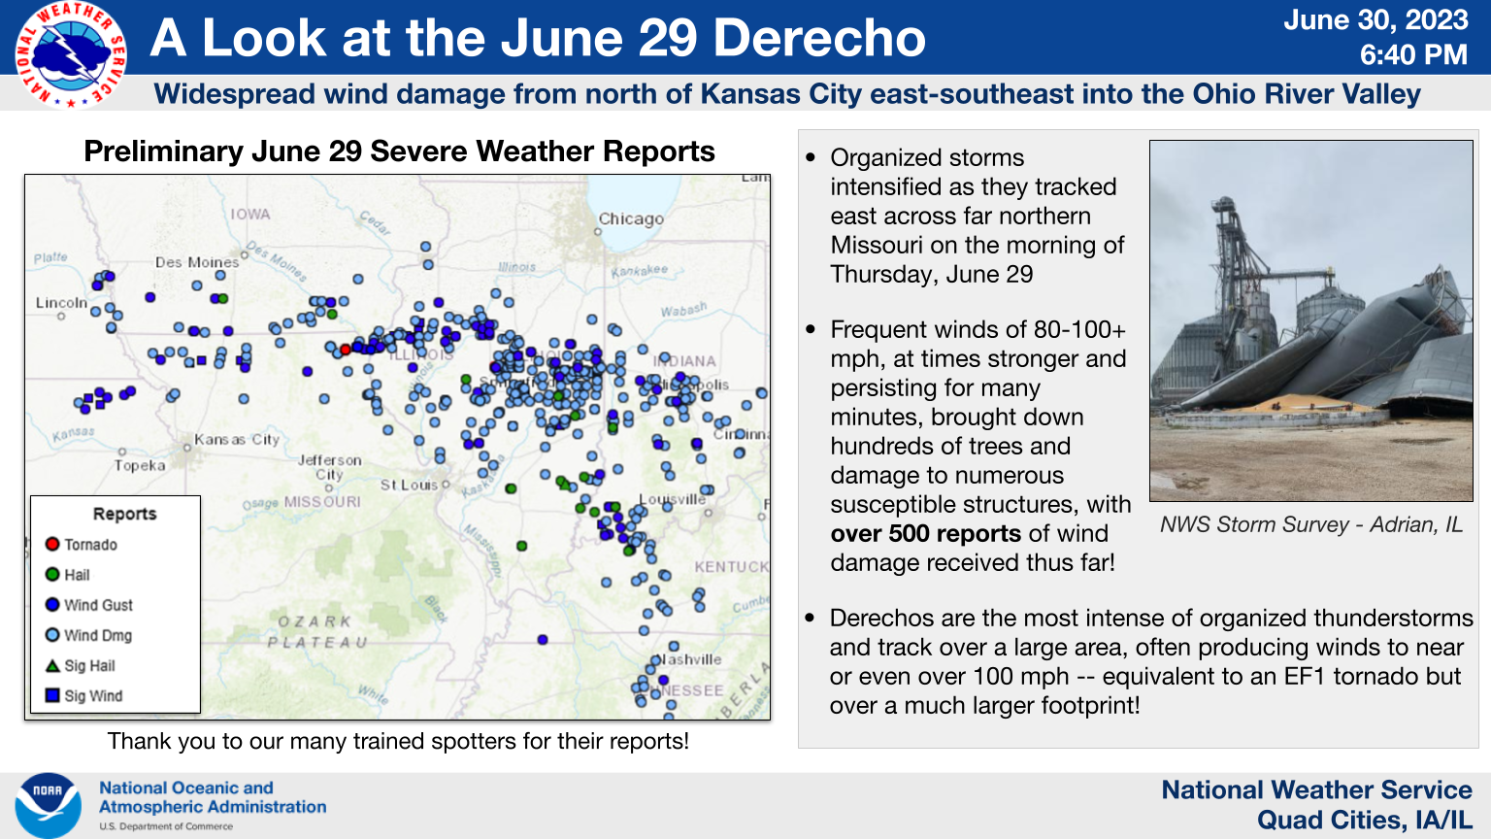
Event Summary
https://www.weather.gov/images/dvn/Past_Events/2023/0629/derecho_overview.png

Slide 4
Datasets used for impact assessment
Using NOAA Real-Time Mesoscale Analysis (RTMA) wind speed (gust) for wind damage assessment. RTMA data is a high-spatial and temporal resolution analysis for near-surface weather conditions. This dataset includes hourly analyses at 2.5 km for CONUS. (https://developers.google.com/earth-engine/datasets/catalog/NOAA_NWS_RTMA).
Using the 5 tornado tracks identified by NOAA NWS for wind damage assessment.
Using Sentinel-1 SAR images for flood impact assessment. SAR images acquired from July 3 and July 8 cover northwestern, central and southern Illinois, central and southwestern Indiana, western Kentucky, and eastern Missouri.
A severe weather system that swept through a large section of central Illinois on June 29, 2023, damaged some crops while bringing much needed rain to others. (https://brownfieldagnews.com/news/derecho-flattens-some-central-illinois-crops-brings-needed-rain-to-others)

Slide 5
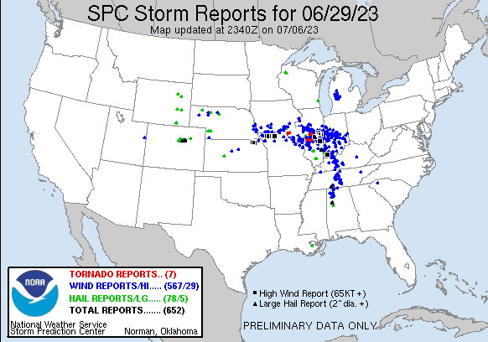
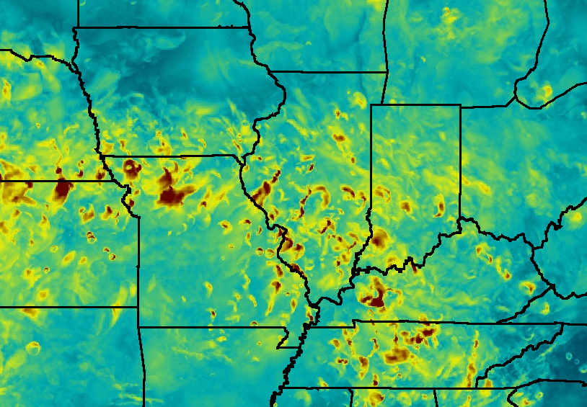

NOAA Real-Time Mesoscale Analysis (RTMA)
20230629's Storm Reports (20230629 1200 UTC - 20230630 1159 UTC)
Maximum wind gust speed (2023-06-29, 00:00:00 – 2023-07-01, 23:00:00) extracted from Google Earth Engine
https://www.spc.noaa.gov/exper/archive/event.php?date=20230629
+

Slide 6
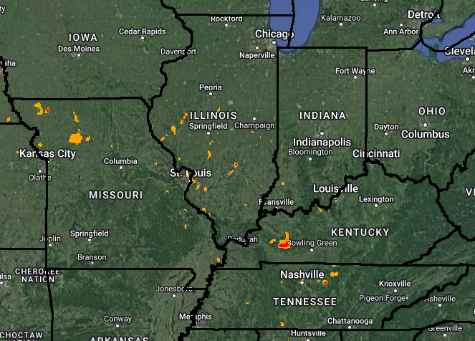
NOAA Real-Time Mesoscale Analysis (RTMA)
Maximum wind gust speed
EF0 (65-85 mph)
EF1 (86-110 mph)
Maximum wind gust speed (2023-06-29, 00:00:00 – 2023-07-01, 23:00:00) extracted from Google Earth Engine

Slide 7
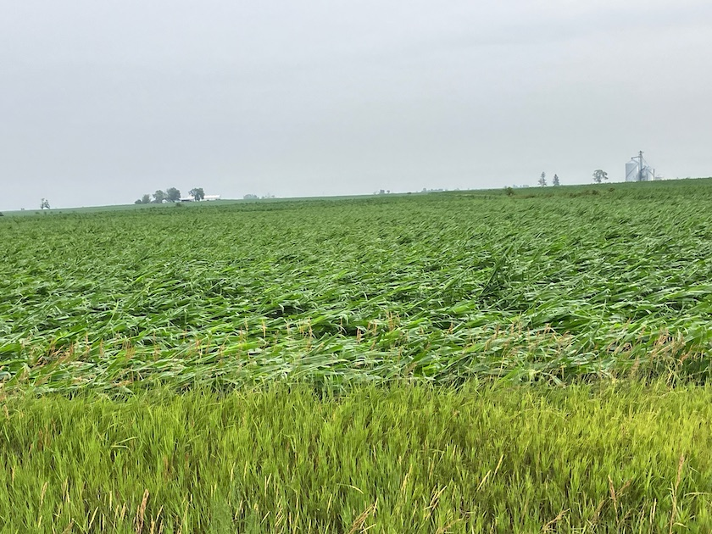
Cultivated land within EF0 and EF1
A corn field flattened near Carthage, Illinois. Photo provided by a Crop-Tech client.
https://www.agweb.com/news/crops/corn/derecho-packs-punch-100-mph-winds-flattens-cornfields-and-crushes-grain-bins-across
Cultivated land impacted

Slide 8
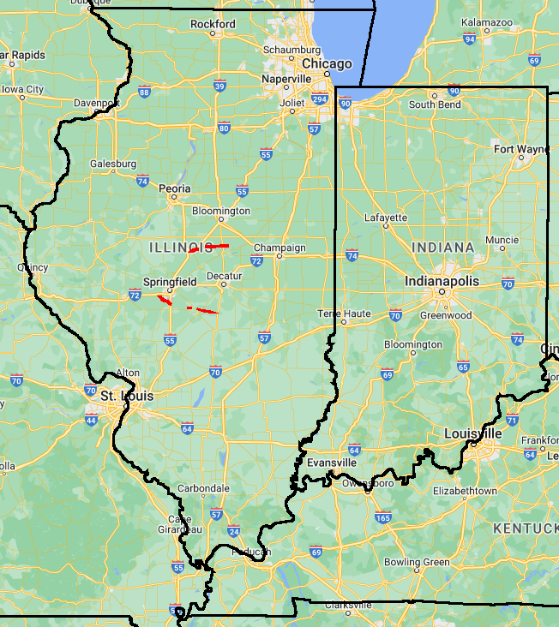
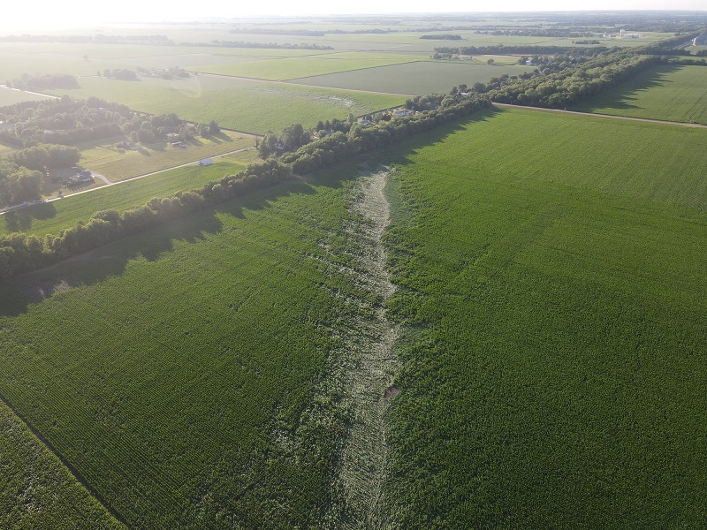
Tornadoes June 29, 2023, Illinois
Tornado track in a corn field near Chatham, IL (Photo by Kyle Golden)
https://www.weather.gov/ilx/june29_derecho
Fields identified were derived from 2022 CDL
Assessment was conducted by buffering the tornado tracks (using the maximum width) identified by NOAA NWS (https://www.weather.gov/ilx/june29_derecho)

Slide 9
Crops impacted by wind
*Total Statewide acres based on official 2022 NASS estimates of acres planted (corn and soybeans)
https://quickstats.nass.usda.gov/#C646E7A6-2A2A-31A5-87C9-07F49E7958A0

Slide 10
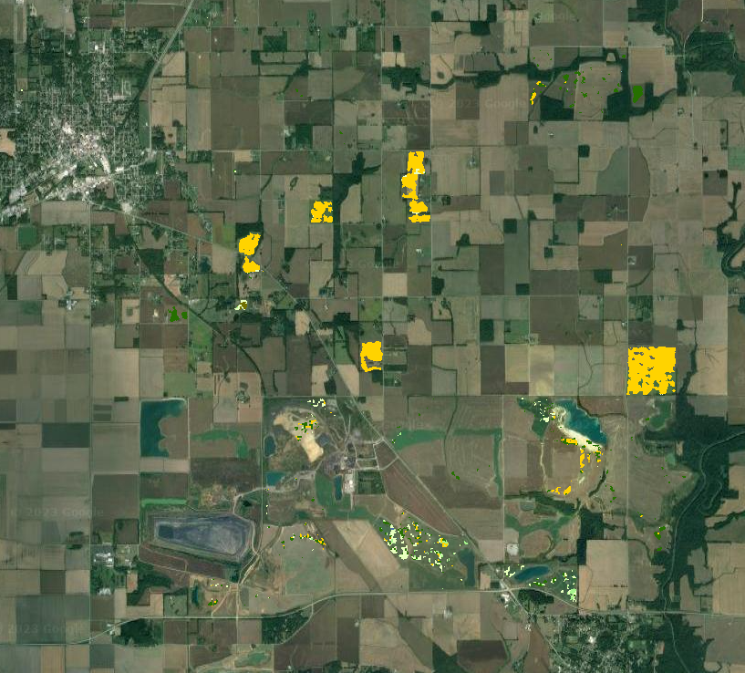
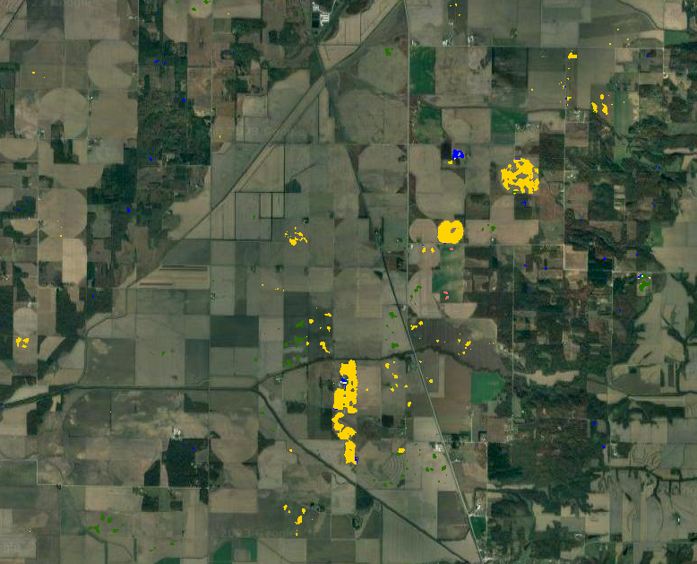
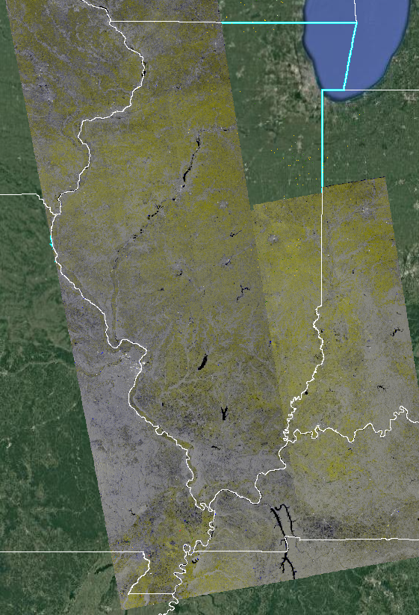
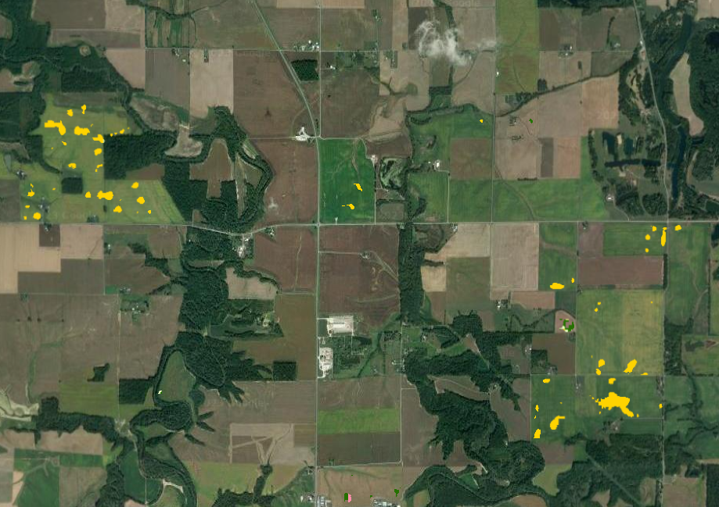
Flood detection from Sentinel-1 SAR images, Illinois
Illinois
Flooded crops
Corn
Soybeans
Fields identified were derived from 2022 CDL

Slide 11
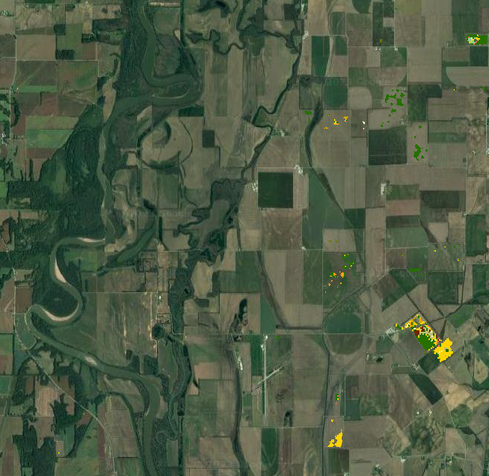
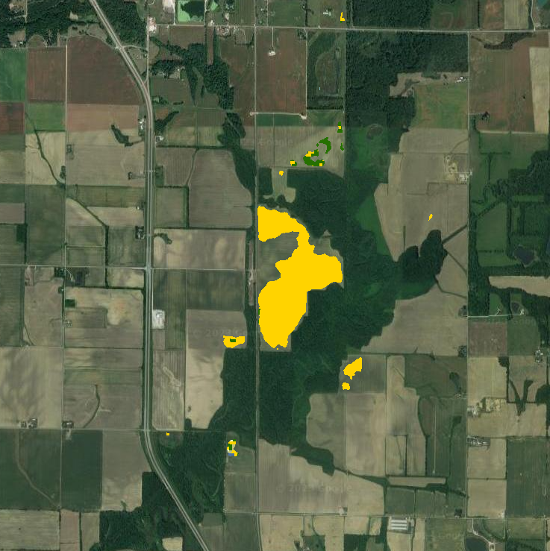
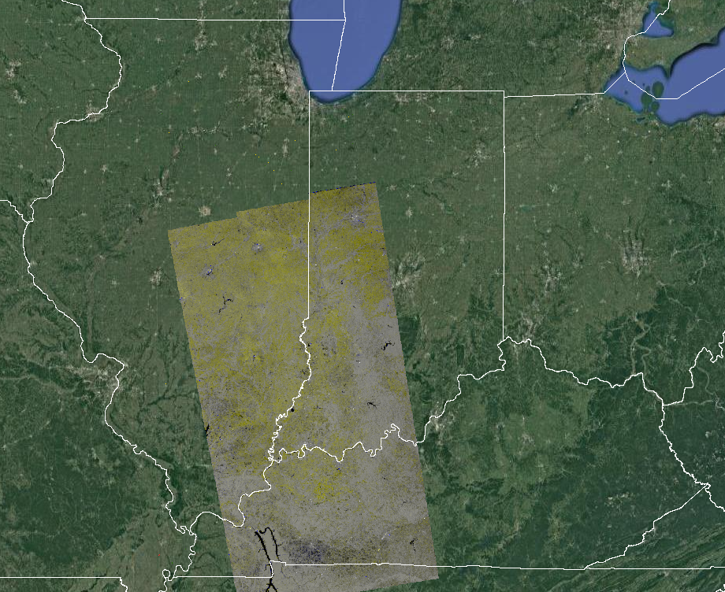
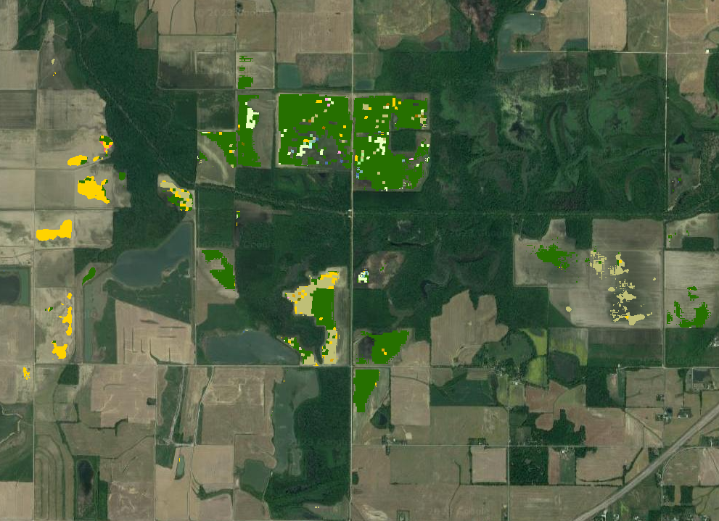
Flood detection from Sentinel-1 SAR images, Indiana
Indiana
Flooded crops
Corn
Soybeans
Fields identified were derived from 2022 CDL

Slide 12
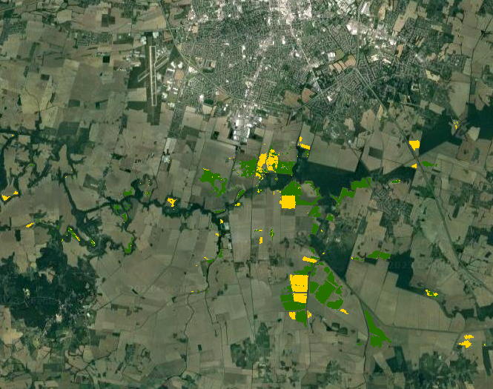
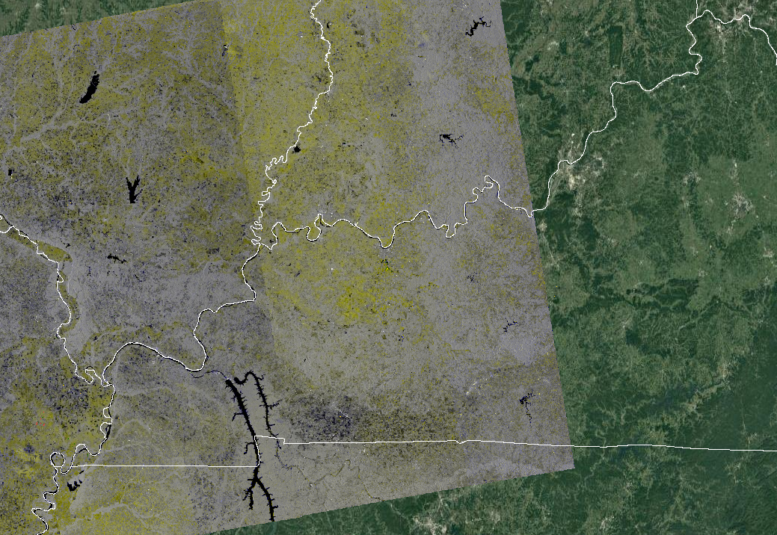
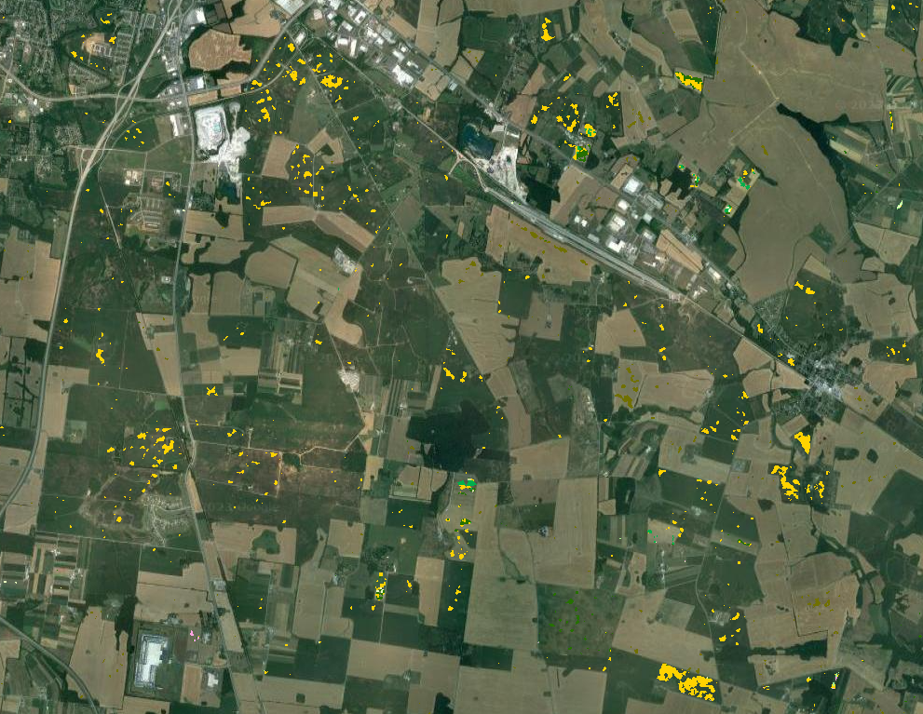
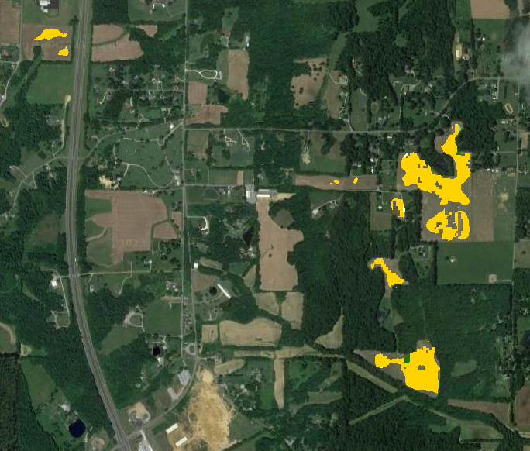
Flood detection from Sentinel-1 SAR images, Kentucky
Kentucky
Flooded crops
Corn
Soybeans
Fields identified were derived from 2022 CDL

Slide 13
Flood detection from Sentinel-1 SAR images, Missouri
Missouri
Flooded crops
Corn
Soybeans
Fields identified were derived from 2022 CDL

Slide 14
Crops impacted by floods
*Total Statewide acres based on official 2022 NASS estimates of acres planted (corn and soybeans)
https://quickstats.nass.usda.gov/#C646E7A6-2A2A-31A5-87C9-07F49E7958A0

