Slide 1
Hurricane Nicole
Assessment Period: November 10-12, 2022
Publication Date: November 28, 2022
USDA NASS
Disaster Monitoring Team

Slide 2
Event Summary
Event: Hurricane Nicole (Category 1 Atlantic Hurricane)
https://www.corelogic.com/intelligence/hurricane-nicole-a-rare-november-event
Location: Florida
Timeframe: Early November 2022
Hurricane Nicole made landfall in Florida on November 10, 2022
Agriculture Affected: Oranges, other citrus

Slide 3
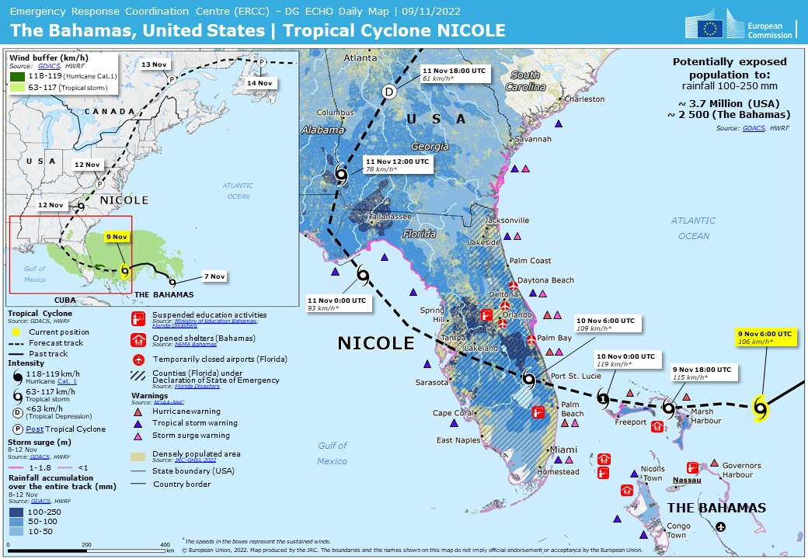
Event Summary
https://www.gdacs.org/report.aspx?eventtype=TC&eventid=1000948

Slide 4
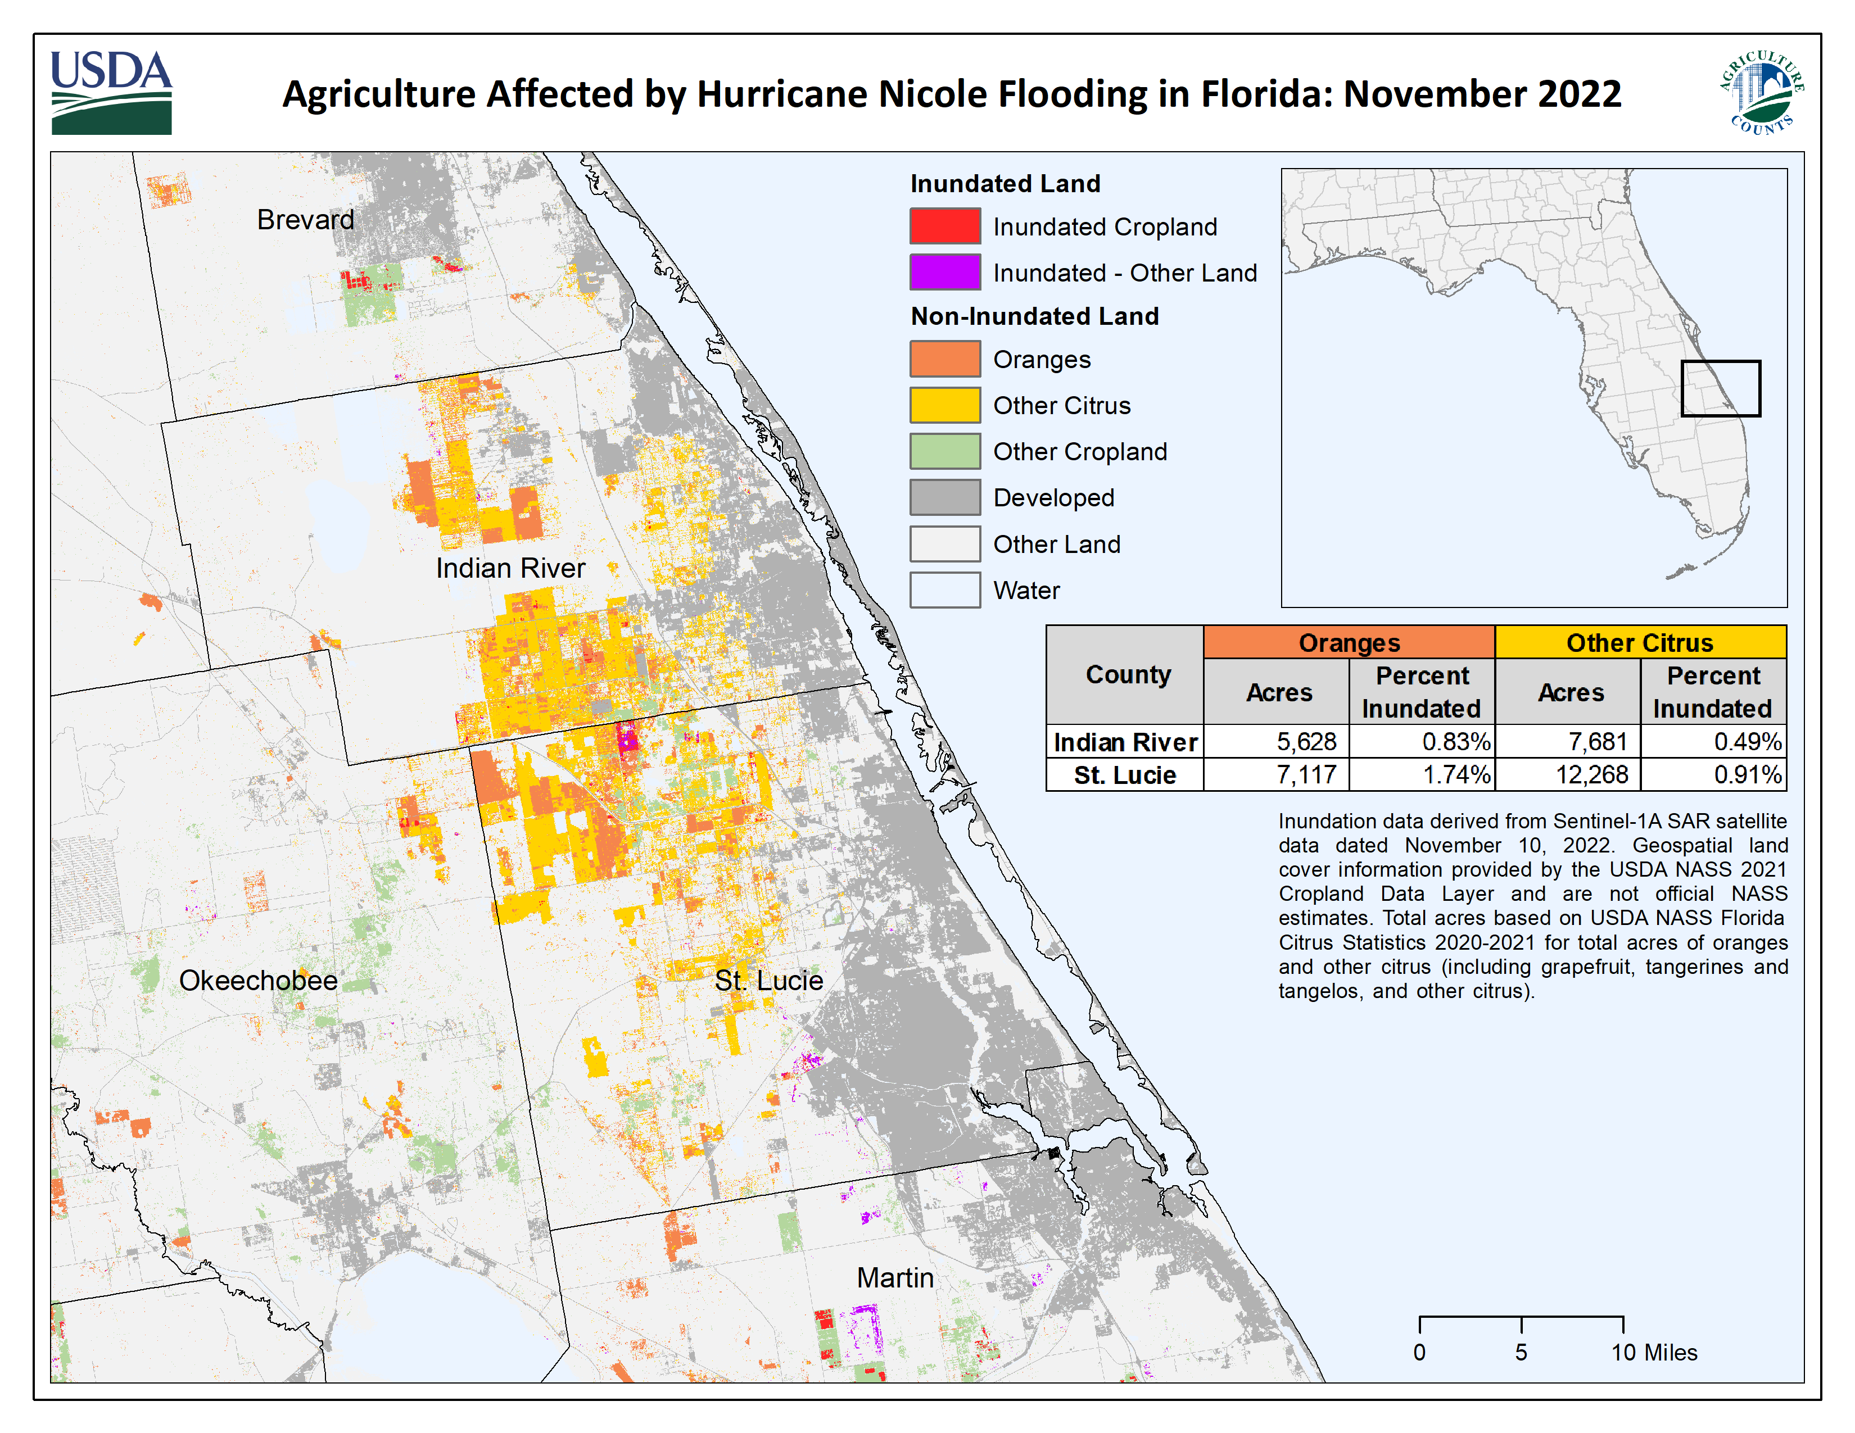

Slide 5
County acres based on the USDA NASS Florida Citrus Statistics 2020-2021 for total acres of oranges and other citrus (including grapefruit, tangerines and tangelos, and other citrus) (https://www.nass.usda.gov/Statistics_by_State/Florida/Publications/Citrus/Citrus_Statistics/2020-21/fcs2021b.pdf).

